Slide 1
SS3 Models for the Yellowfin Case Study
Agurtzane Urtizberea Ijurco, Dan Fu, Massimiliano Cardinale, Richard Methot, Kathryn Doering

Slide 2
SS3 Area and Tag Capabilities
Areas as virtual compartments
Global spawner pool summed across areas
Recruits distributed among designated areas
Movement as % transfer among designated source-sink areas
Fleets assigned to single area, but can share selectivity pattern
Tags are seeded into an area at designated age
Recaptured tags tracked over time to inform mortality
Distribution of recaptured tags across fleets (areas) informs movement

Slide 3
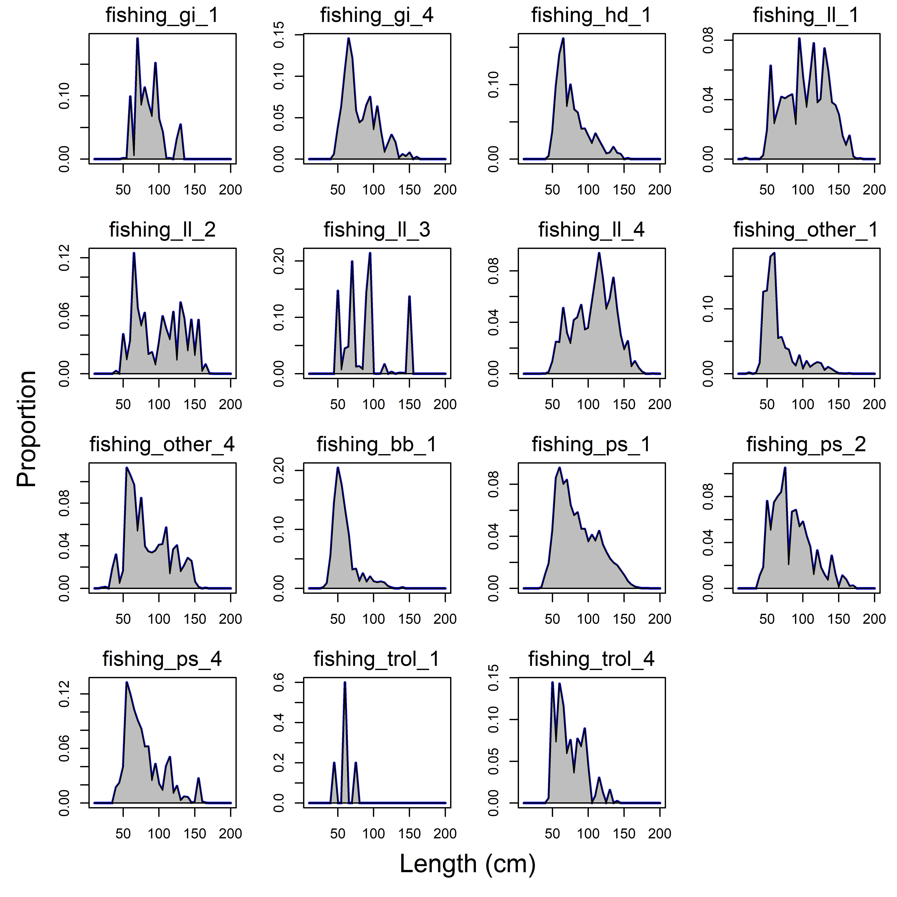
4-region model fleet structure
Fishery | Gear | Region | Selectivity
1. gi_1 | Gillnet | 1 | Double normal
2. gi_4 | Gillnet | 4 | Double normal
3. hd_1 | Handline | 1 | Double normal
4. ll_1 | Longline | 1 | logistic
5. ll_2 | Longline | 2 | logistic
6. ll_3 | Longline | 3 | logistic
7. ll_4 | Longline | 4 | logistic
8. other_1 | Misc | 1 | Double normal
9. other_4 | Misc | 4 | Double normal
10. bb_1 | Baitboat | 1 | Double normal
11. ps_1 | Purse seine | 1 | Double normal
12. ps_2 | Purse seine | 2 | Double normal
13. ps_4 | Purse seine | 4 | Double normal
14. trol_1 | Troll | 1 | Double normal
15. trol_2 | Troll | 2 | Double normal
16. trol_4 | Troll | 4 | Double normal

Slide 4
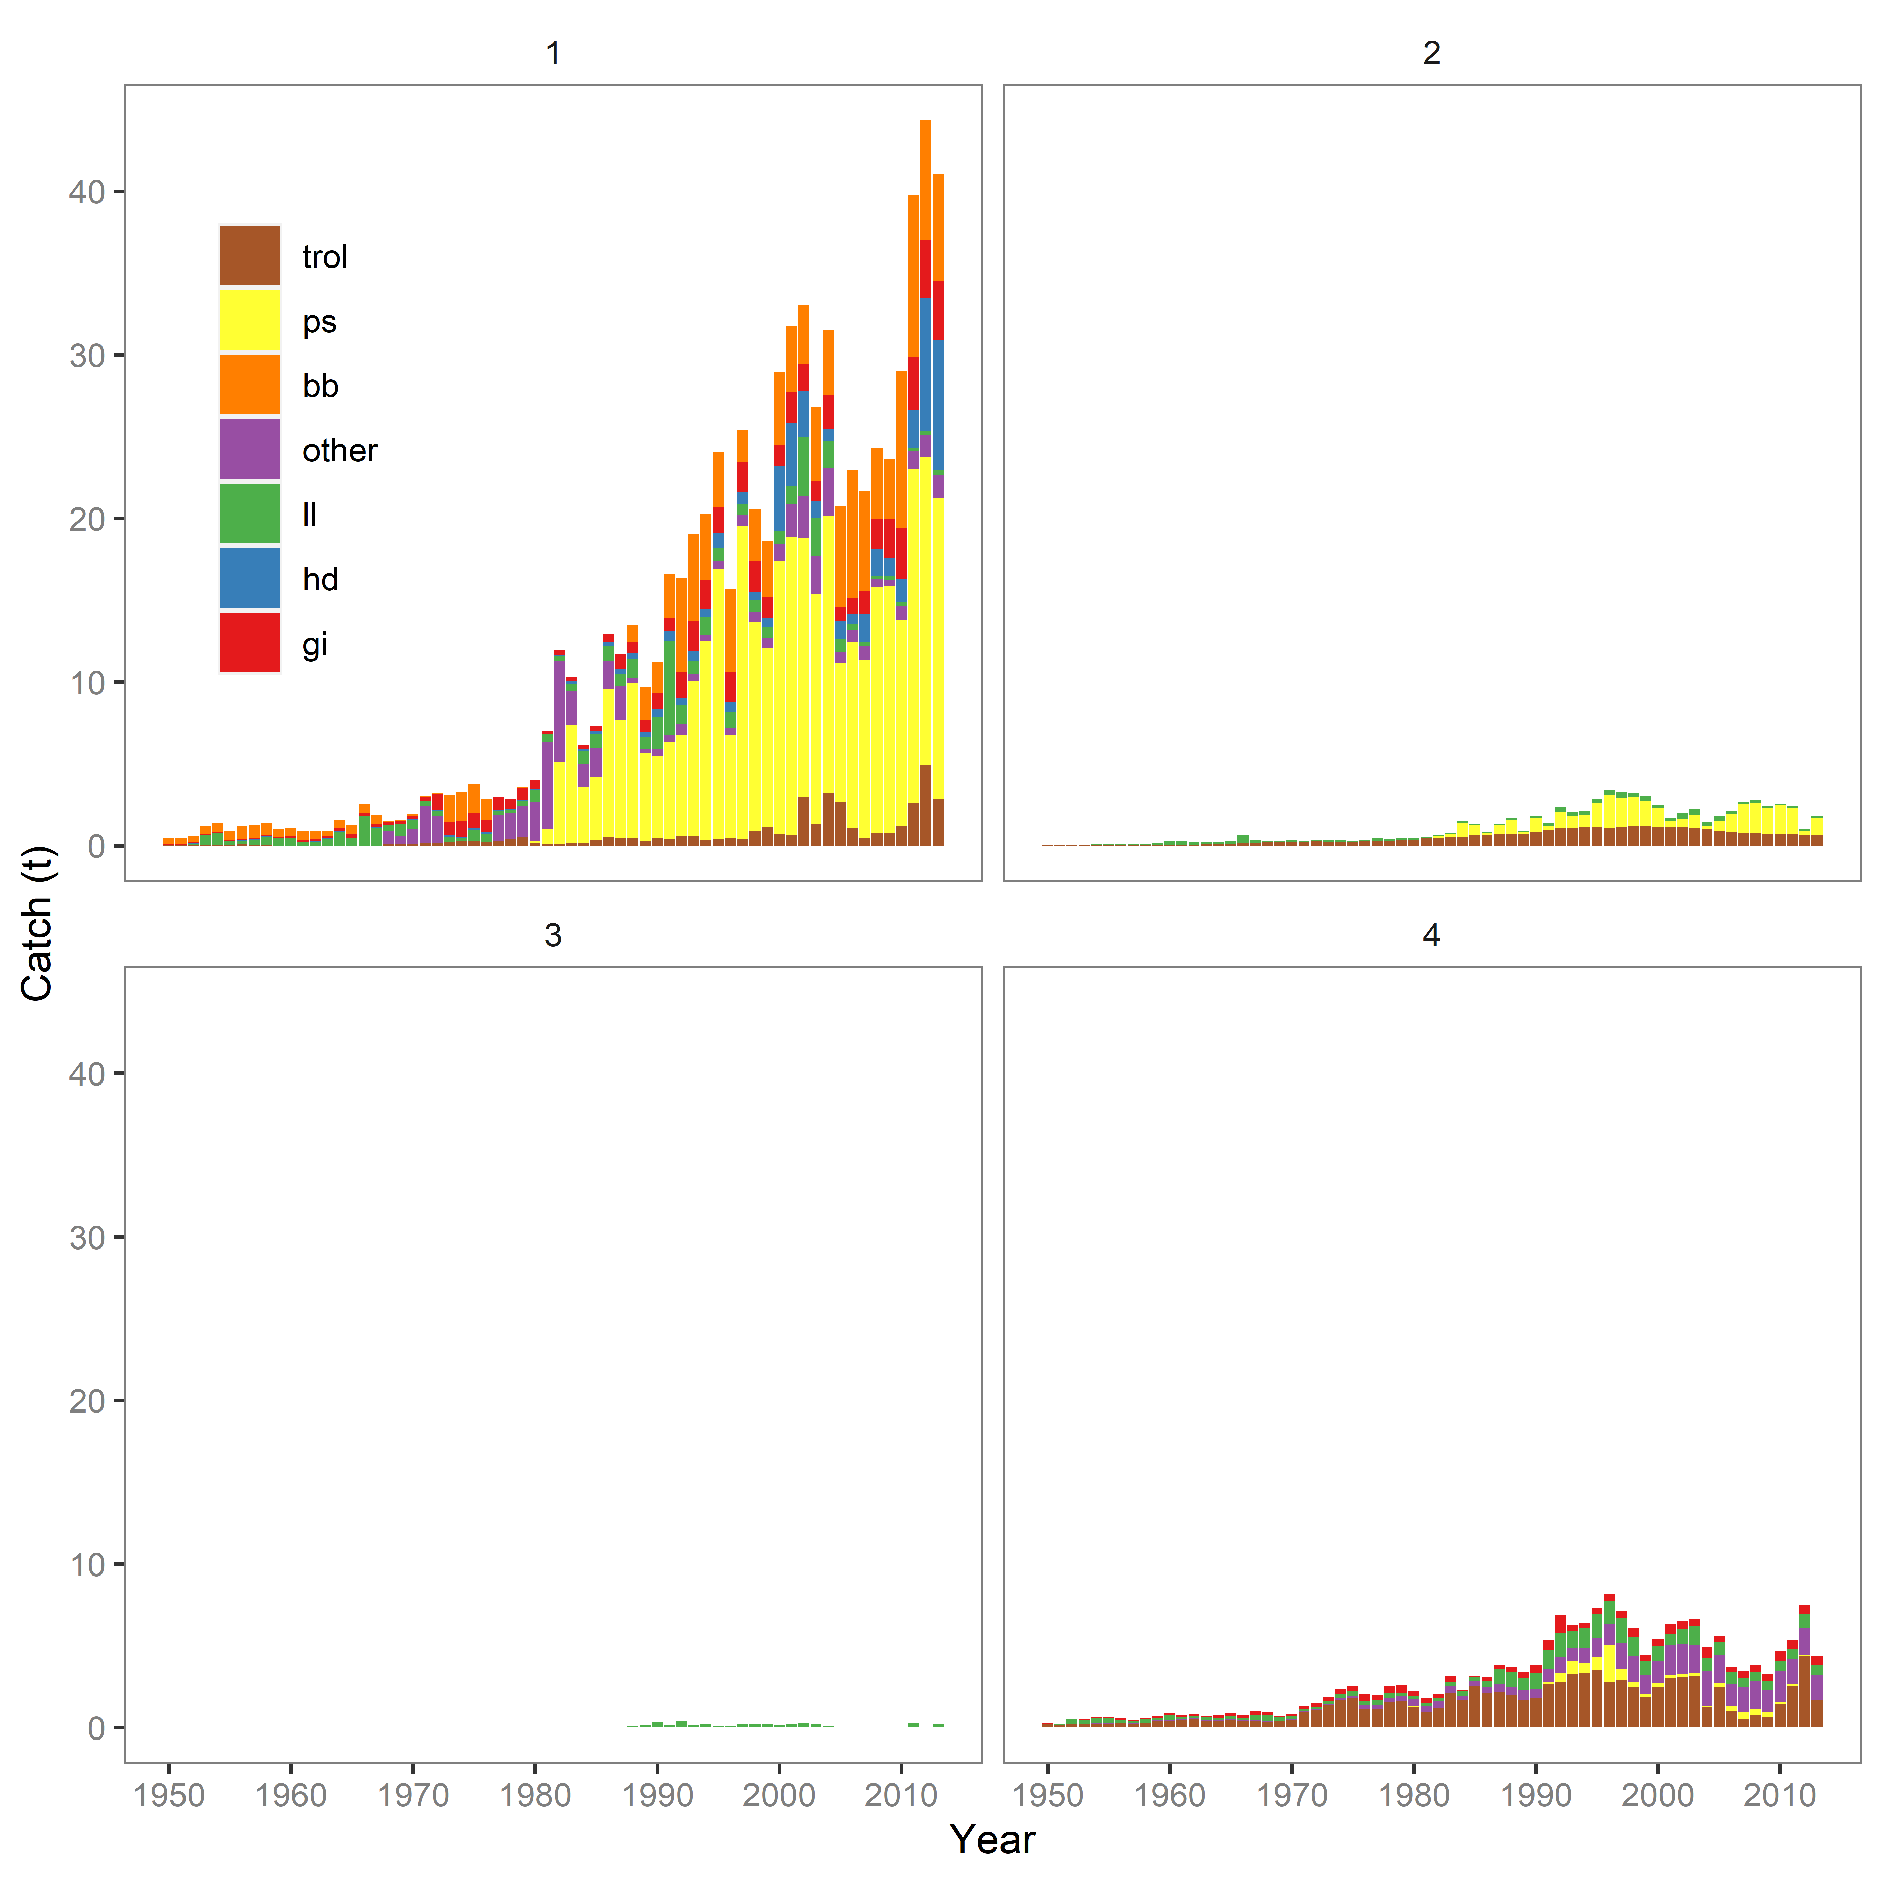
4 regions, 7 gear groups (16 fleets)
Purse seine (40%)
Troll (15%)
Bait boat (13%)
Longline (10%)
Is it necessary to have a separate region if catch is less %1?
~74%
~7%
<1%
~19%

Slide 5
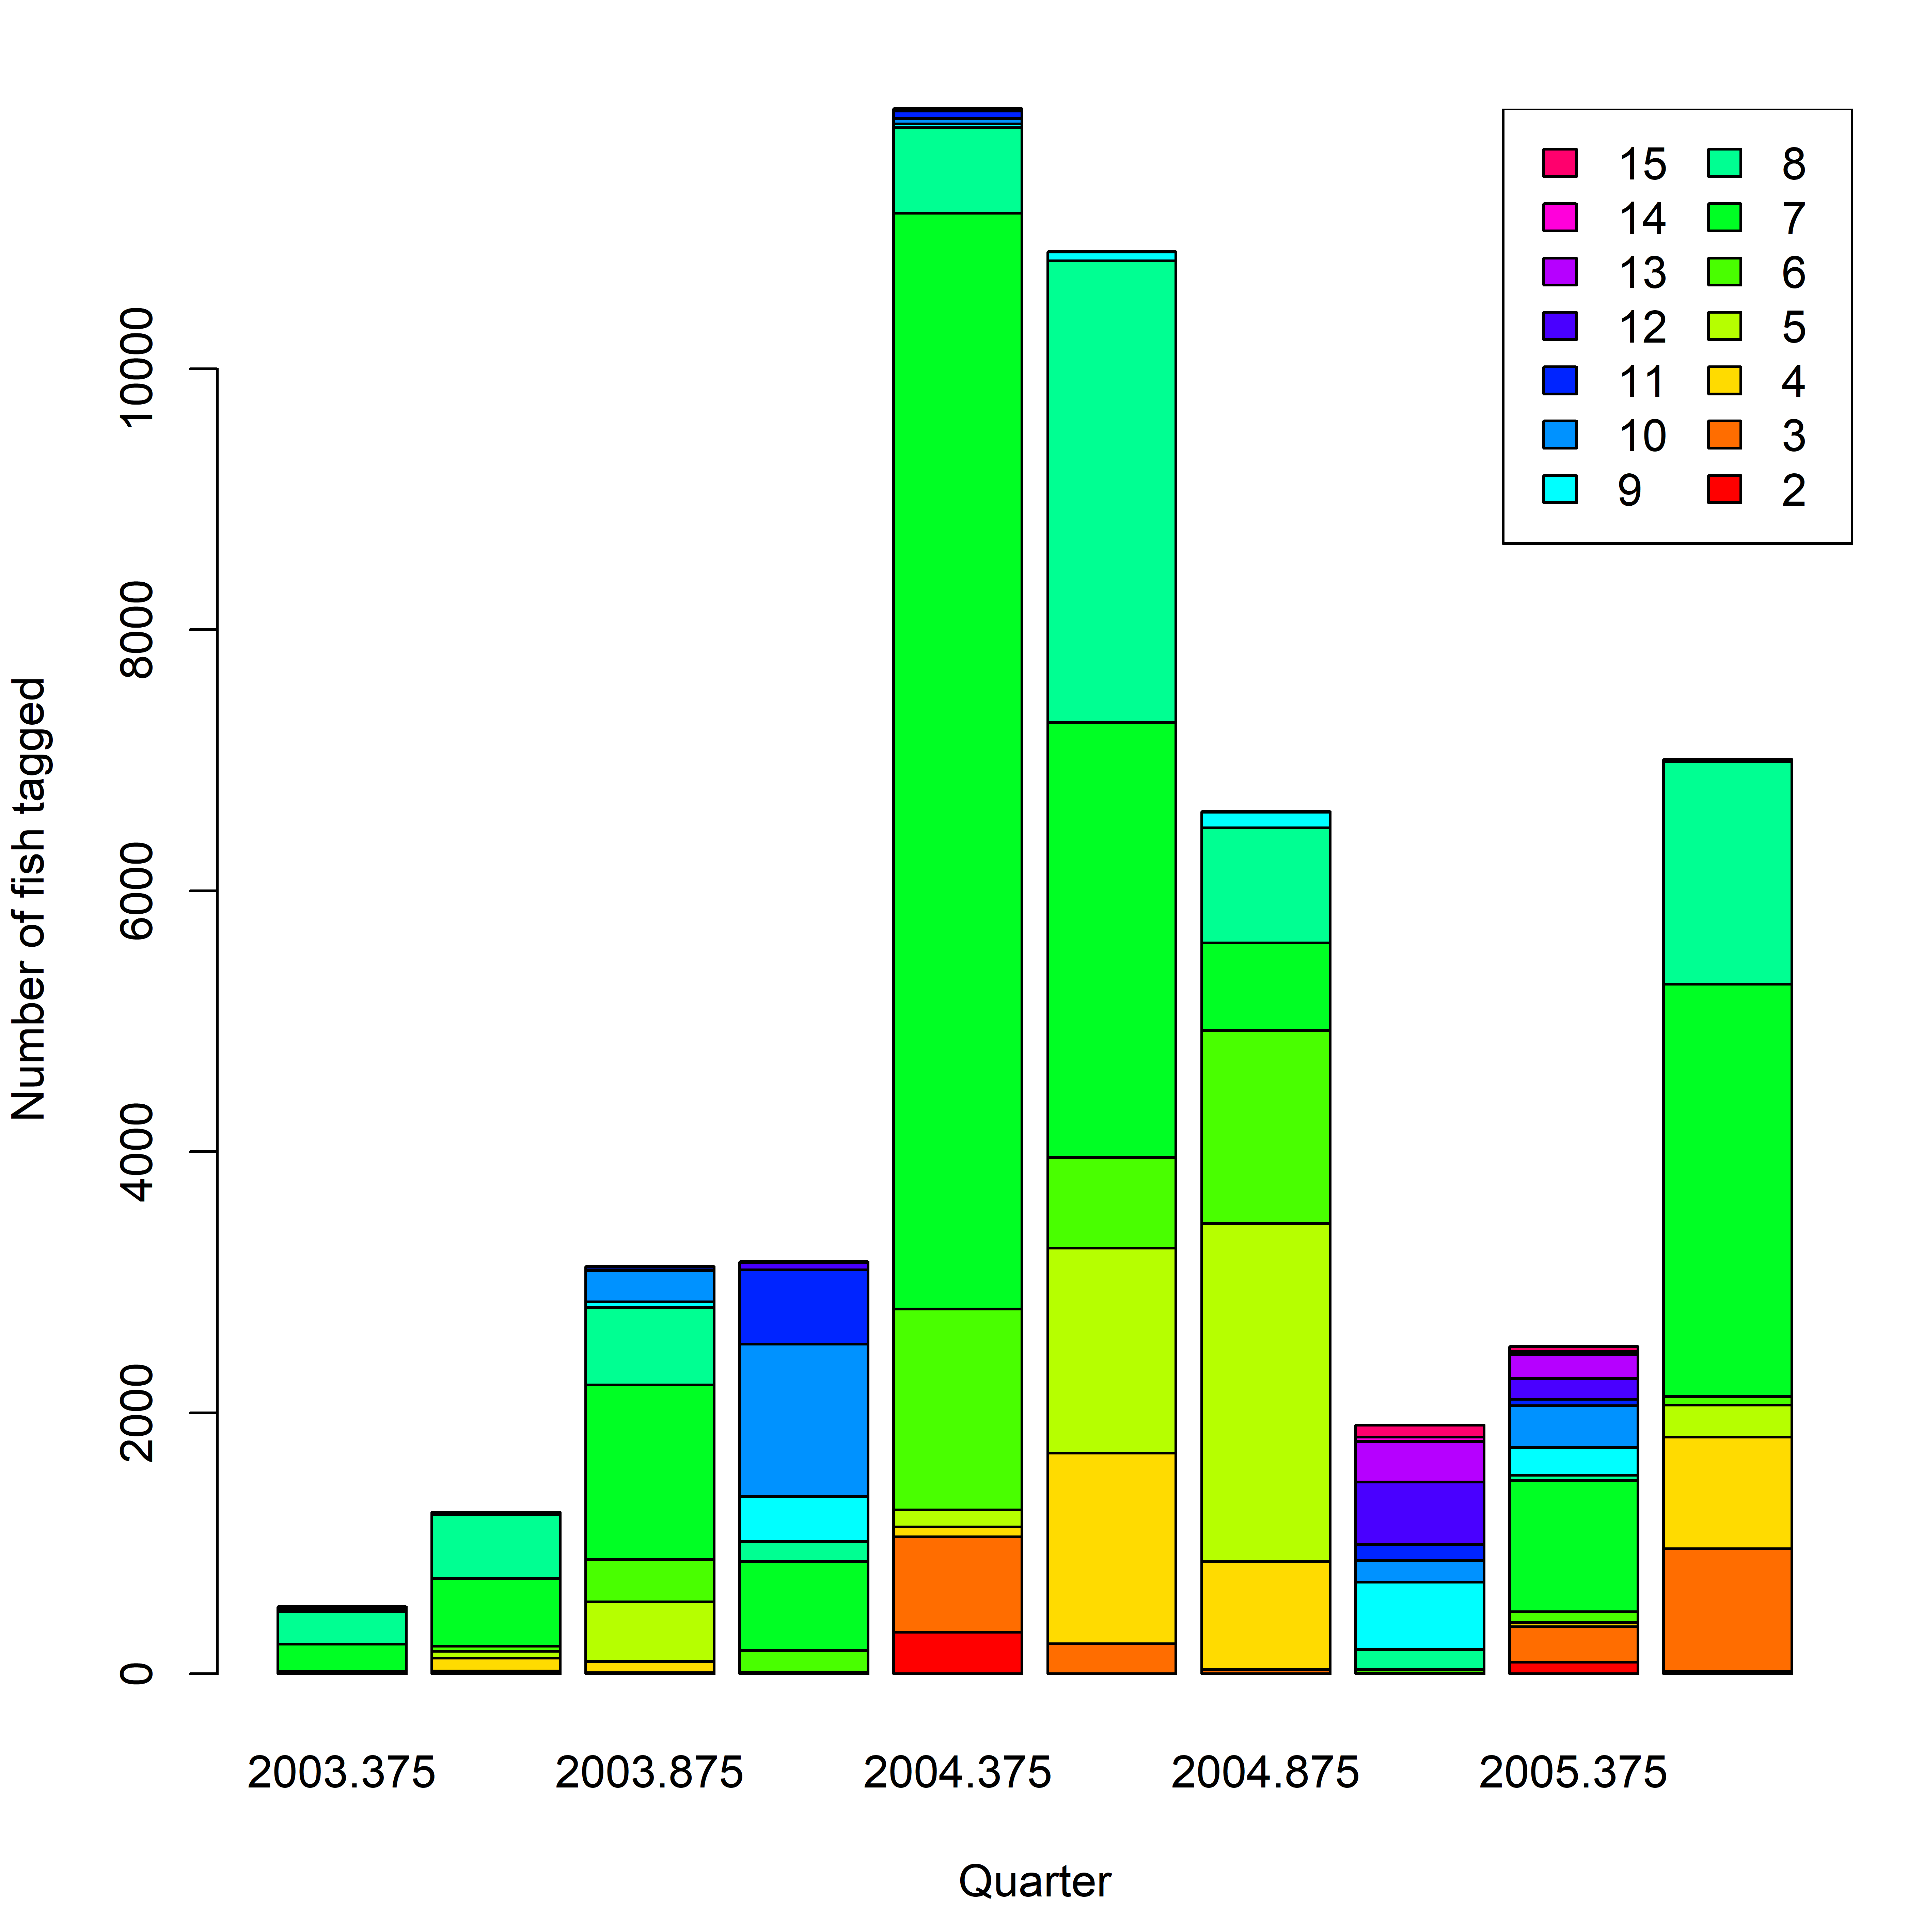
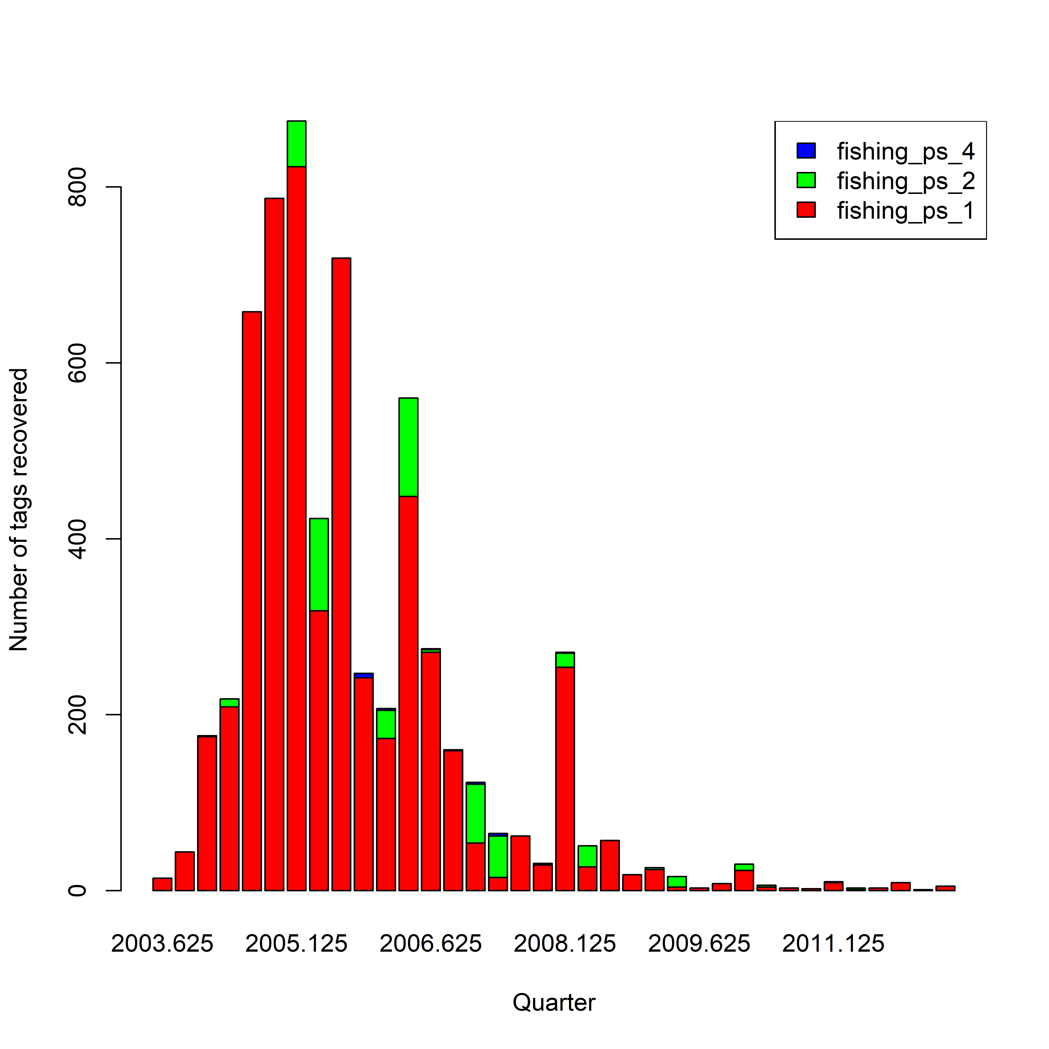
~50 000 releases in region 1, 2003–2005 (assuming model starts 1950)
~6 000 recoveries 2003–2012
Mostly by ps_1, very few by ps_2, and ps_4
Tagging data needs to be analyzed / processed externally
tag loss, reporting rates, mixing, etc.

Slide 6
Model Structure
Spatial SS3 models (3.30)
1-area model (IO)
A single abundance index (LL) and 7 fishery groups
4-area model (IO4)
Similar structure and parametrizations to the IO model
4 regional LL indices and 16 fleets
Regional recruitment and movement
Tagging data included
Model year 1 – 256 (1950 Q1 – 2013 Q4)
Quarter-as-year in (4 recruitments in 12-month)
28 age (quarterly) classes
Fleet-as-Area approach also examined

Slide 7
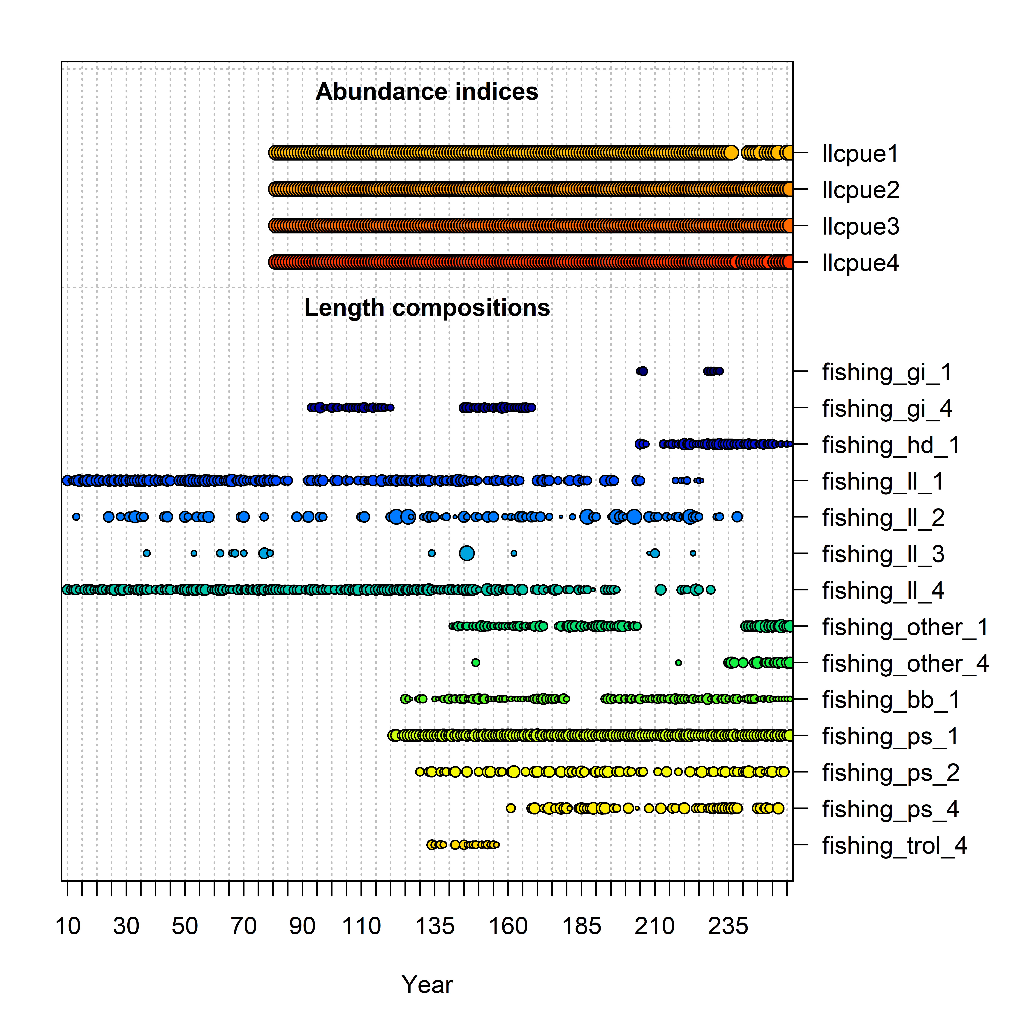
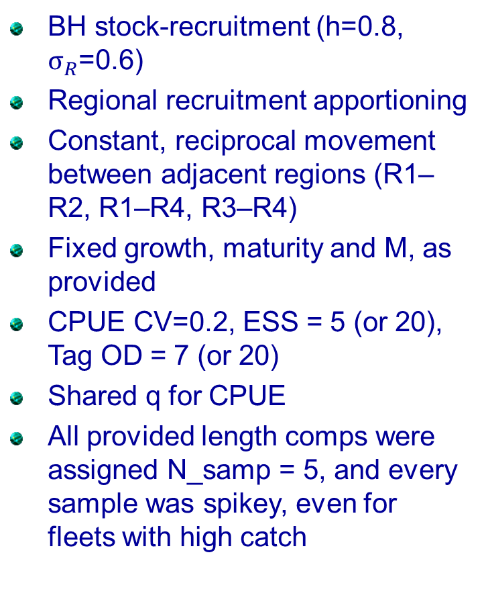
Model structure
BH stock-recruitment (h=0.8, $σ_{R}$=0.6)
Regional recruitment apportioning
Constant, reciprocal movement between adjacent regions (R1–R2, R1–R4, R3–R4)
Fixed growth, maturity and M, as provided
CPUE CV=0.2, ESS = 5 (or 20), Tag OD = 7 (or 20)
Shared q for CPUE
All provided length comps were assigned N_samp = 5, and every sample was spikey, even for fleets with high catch

Slide 8
General conclusions for the study
Observations fitted reasonably and no obvious unexplained patterns
The spatial model better explains the differences in regional abundance trends
Prior constraints on regional biomass distribution is important in the spatial model (i.e., a shared q on regional CPUE)
The data appear not very informative on regional recruitment and migration; confounded/driven by model structure and biomass distribution constraint; spikey length comps
Comparable SSB estimates between IO4 and IO model, if the tagging data is not included

Slide 9
General issues
Differences in the estimation of the scaling parameter (R0) and trends between spatial and non-spatial models
Abundance / biomass distribution amongst model regions
Estimation of movement and recruitment distribution
Effects on the estimation of reference points
Temporal structure: quarter-as-year vs. Year/Season

Slide 10
Is it necessary to structure the fishery by season?
Area 1
Area 2
Area 3
Area 4

Slide 11
Models
1-area model (IO)
How far back should rec dev be estimated?
Influence of tag data
4-area model (IO4)
Should regional recruitment distribution vary over-time?
How is biomass distribution determined?
Model | Description
IO | A single area model, 7 fleets, one aggregated CPUE index
IO-Rec1960 | IO, but estimated recruitment deviations 41–256
IO-NoTag | IO, but excluded the tagging data
IO-AreaAsFleet | A single area model but used the fleet-as-area approach, e.g.,16 fleets as in Table 1 and 4 CPUE indices
IO4 | 4-area spatial reference model
IO4-basic | IO4, but estimated temporal deviates on regional recruitment distributions 109 – 256
IO4-revisesd | IO4, but included only tag release groups if there are > 2 tag returns after the mixing period (4 quarters)
IO4-NoTag | IO4, but excluded the tagging data
IO4-ess20 | IO4, but LF sample size set to 20
IO4-od20 | IO4, over-dispersion parameters for each tag release group set to 20
IO4-NoMove | IO4, but assumed no movement between regions (move parameter set to 0)

Slide 12
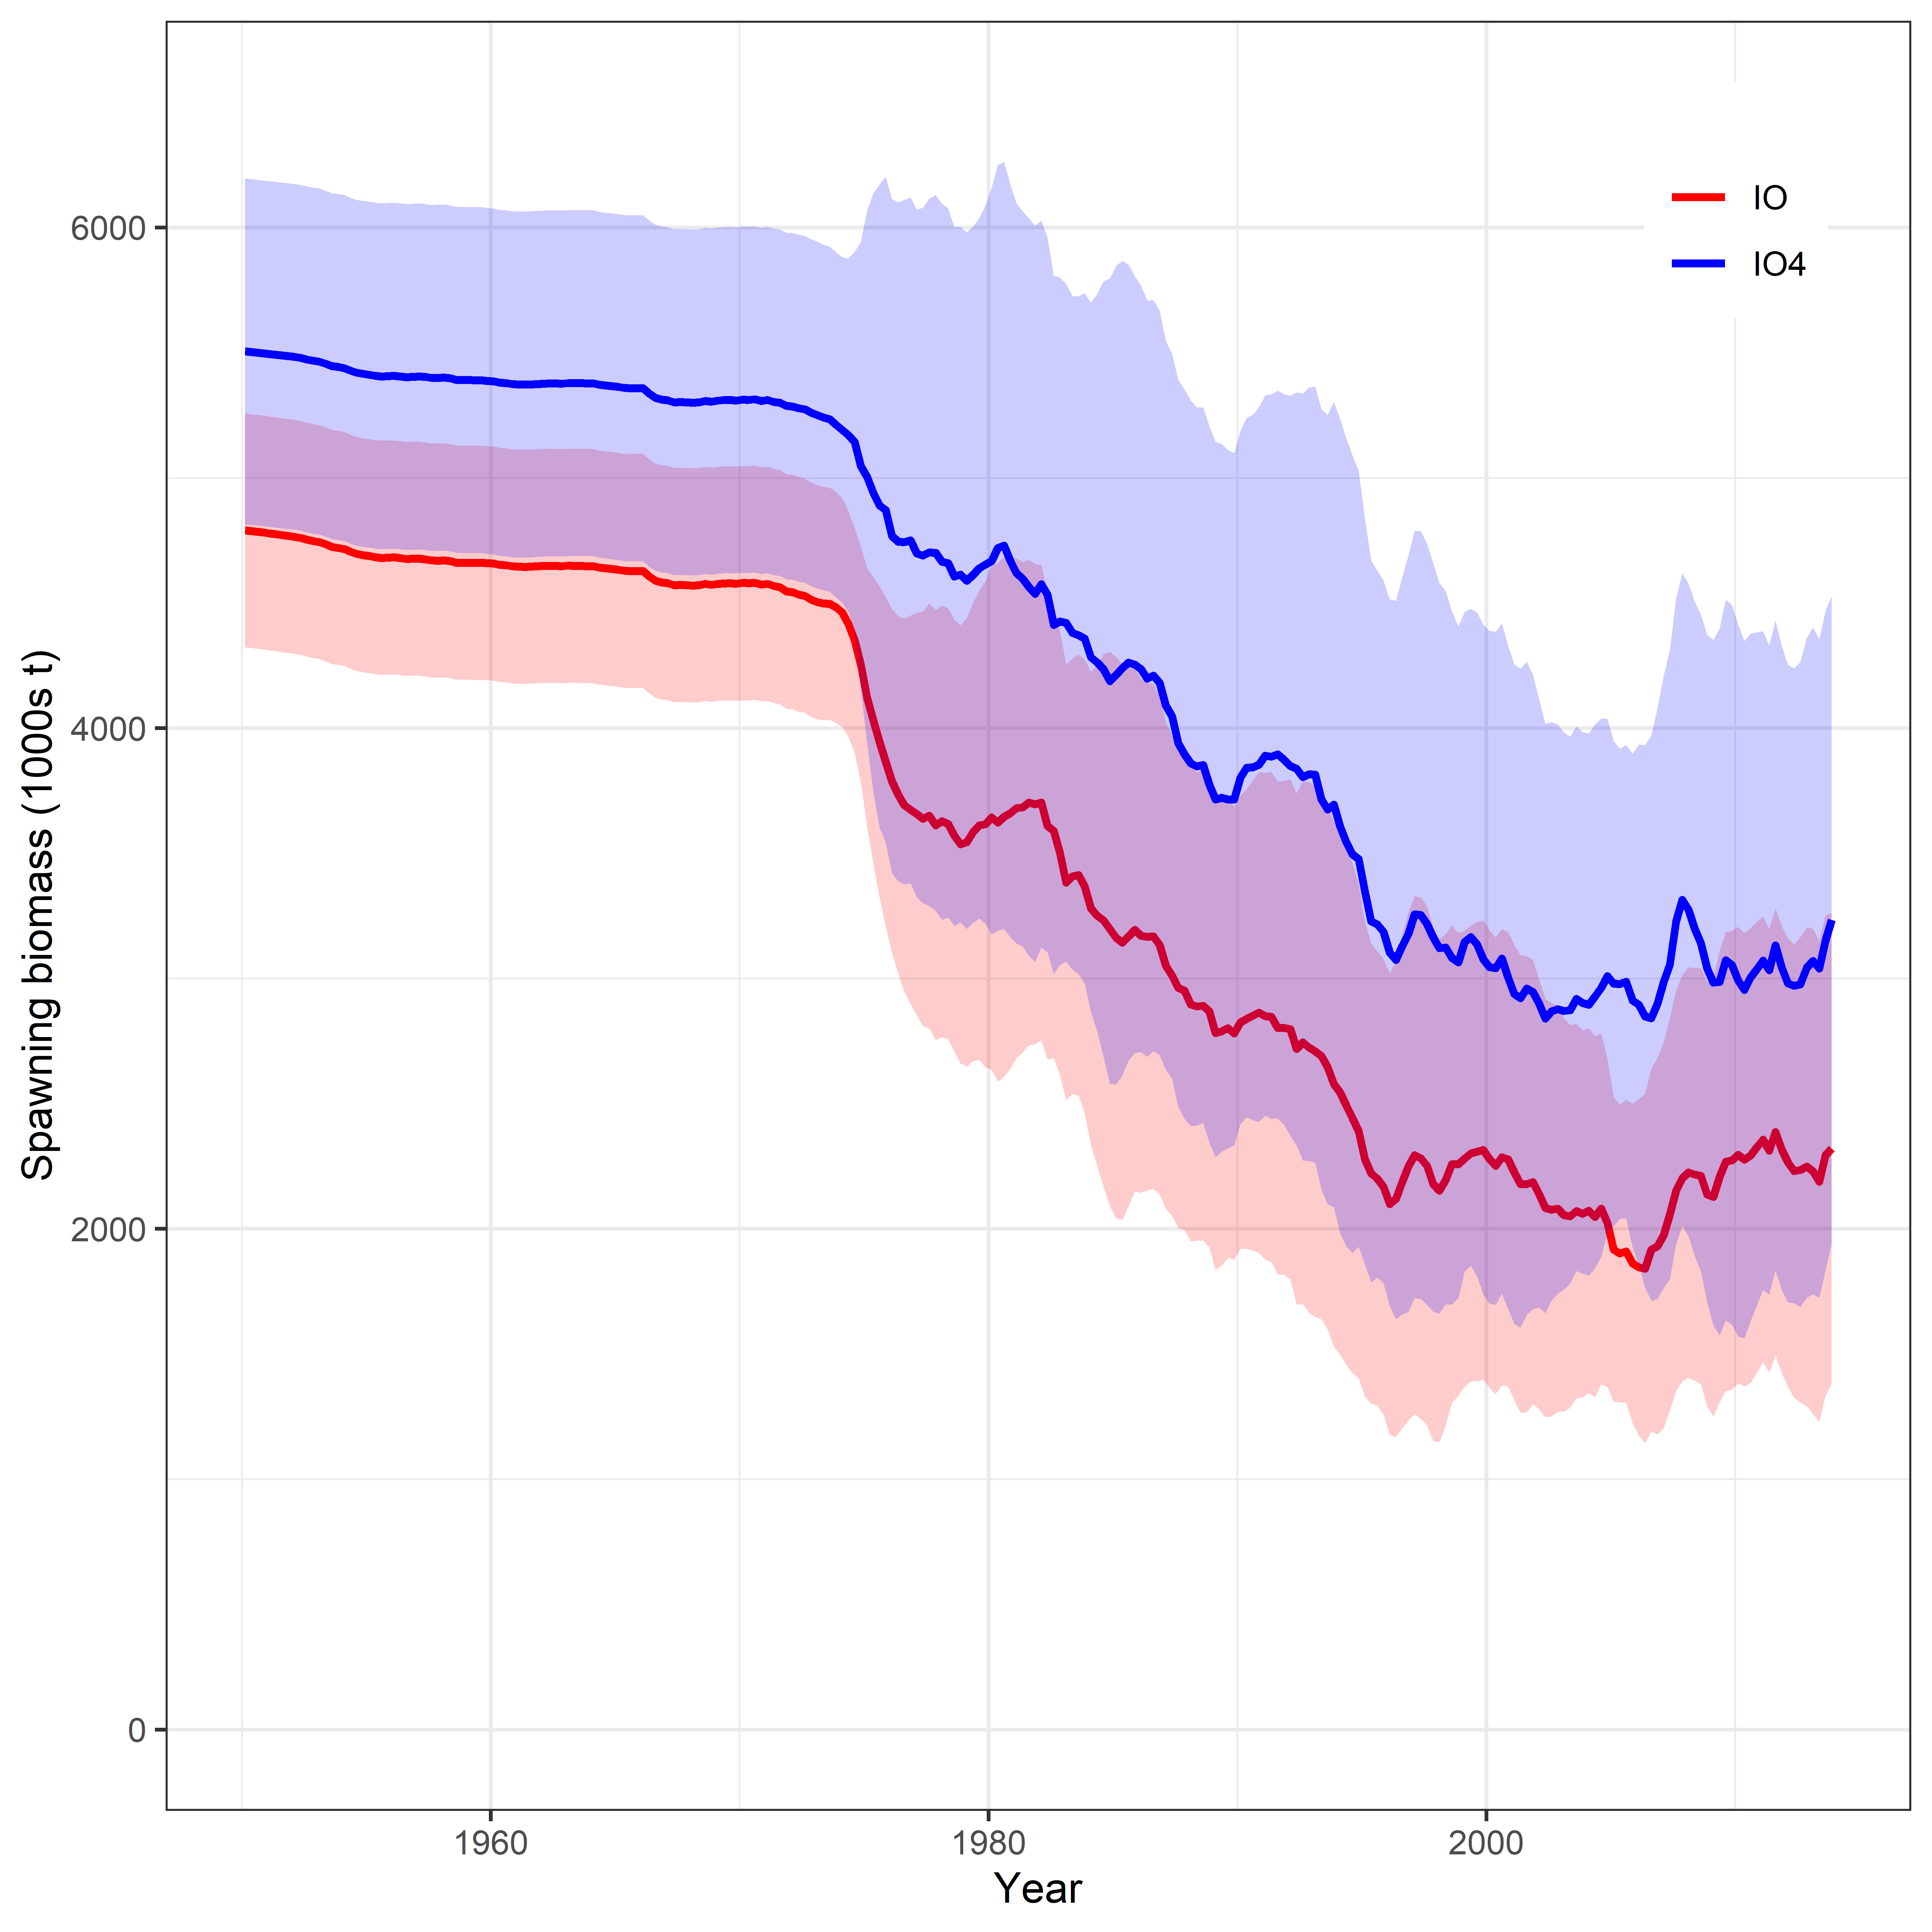
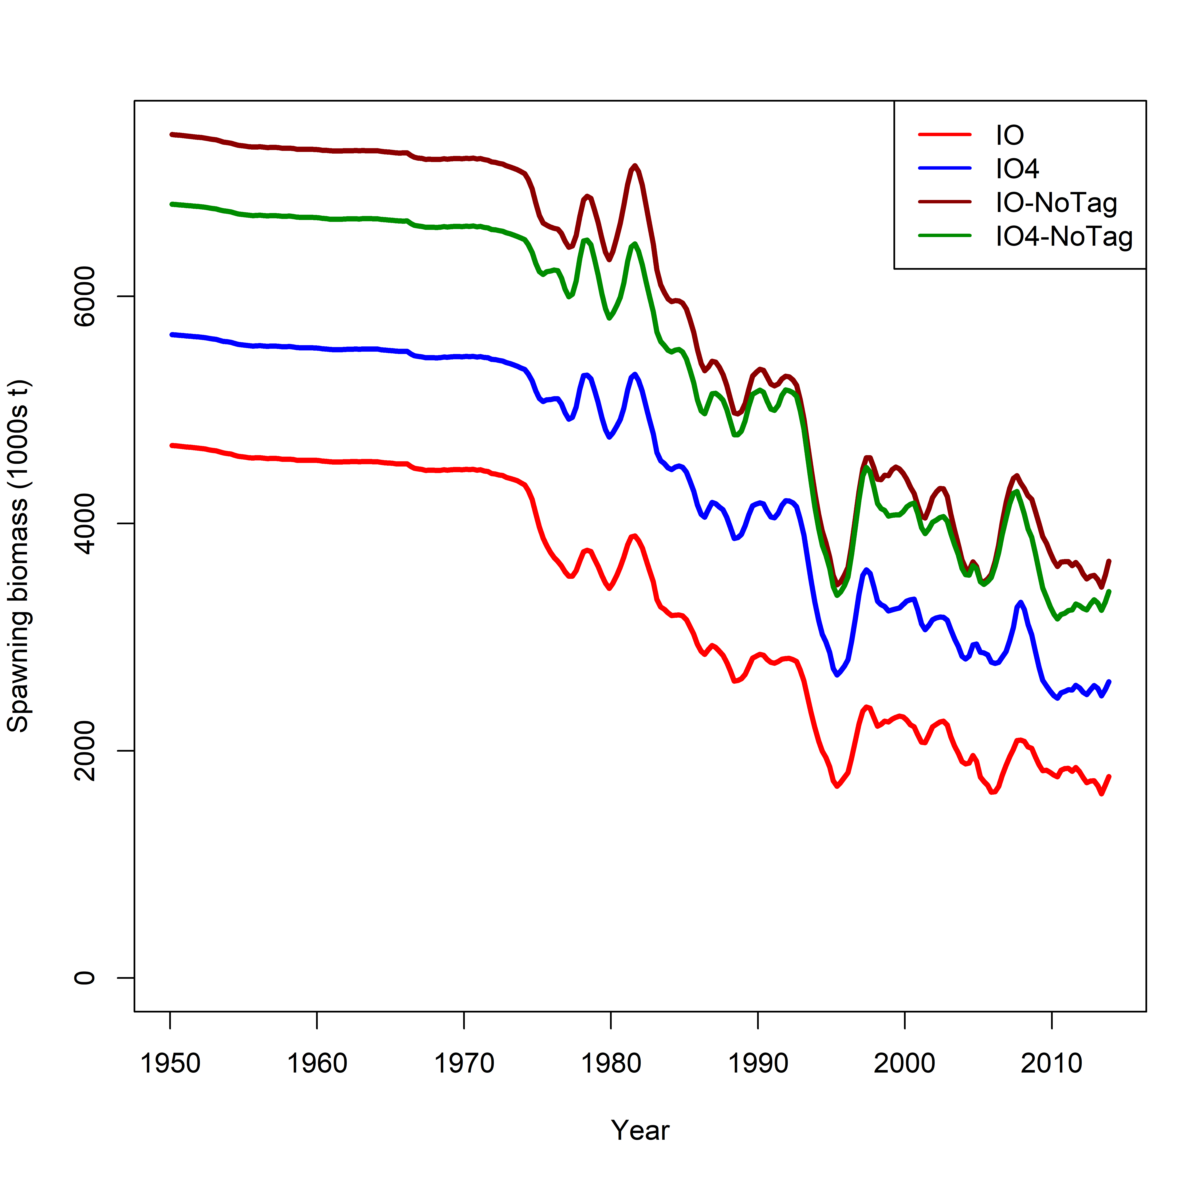
1-Area (IO) vs. 4-Area (IO4)
~20% difference in SSB between IO and IO4 models
Better agreement without tagging data
Larger influence of tagging data in the IO model than the IO4 model

Slide 13
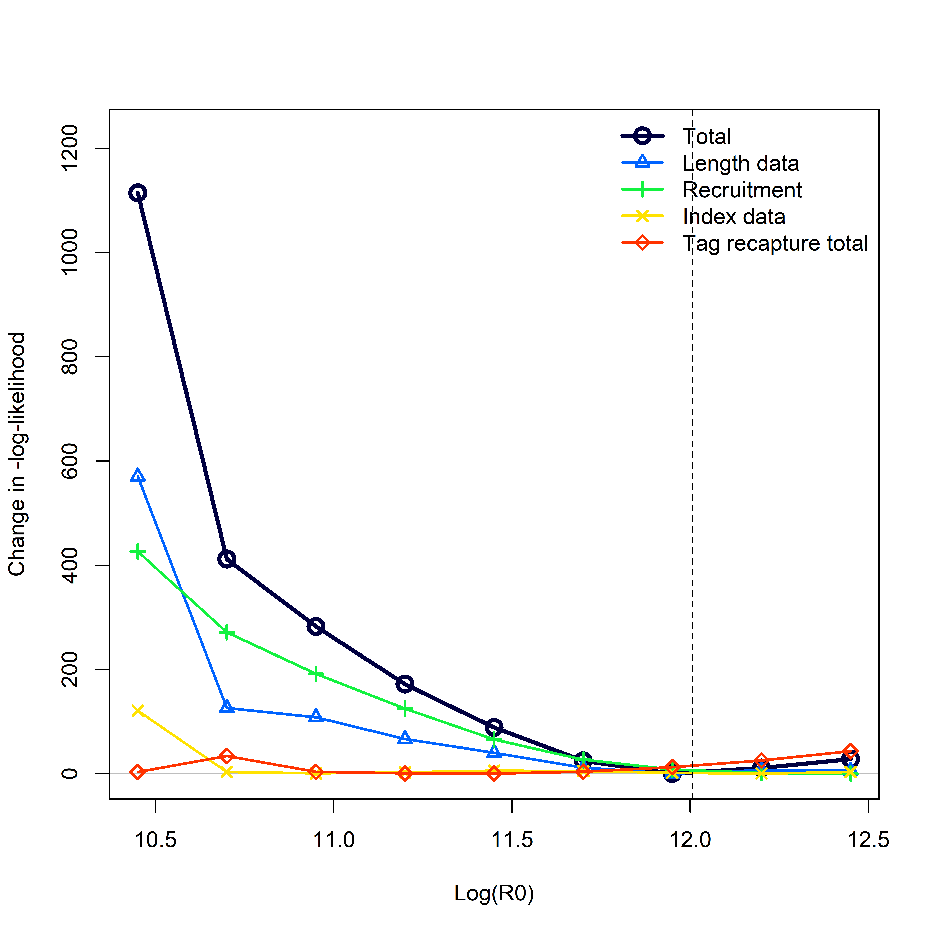
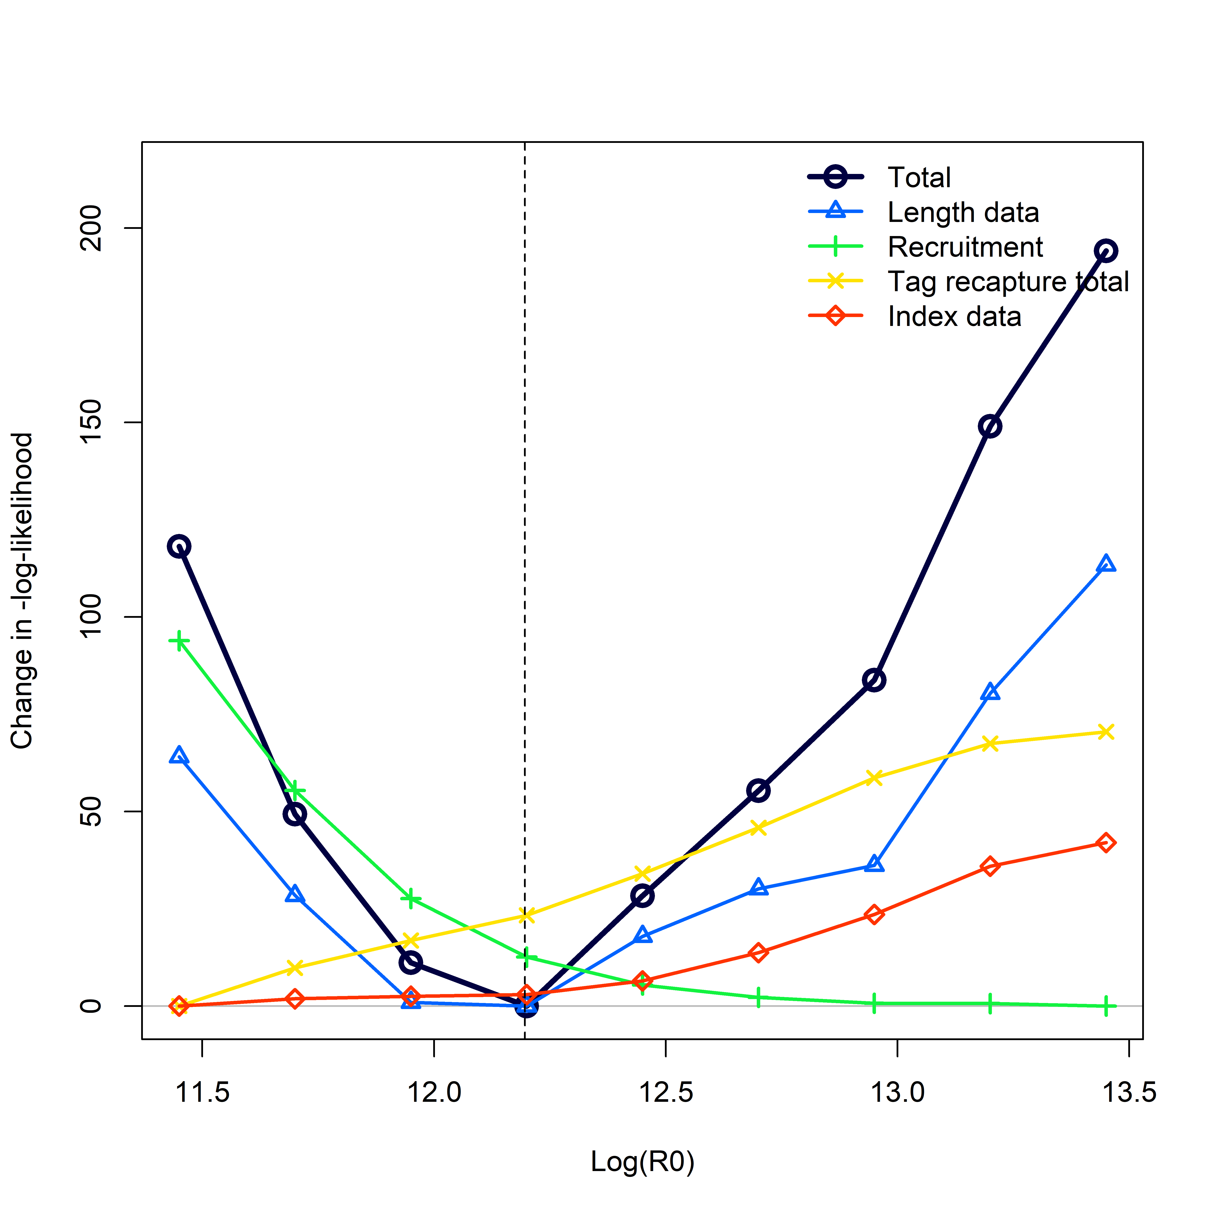
1-Area (IO) vs. 4-Area (IO4)
Recruitment dev influential, but mostly bounding R0 from below
IO model – data appears not informative on the upper bound of R0

Slide 14
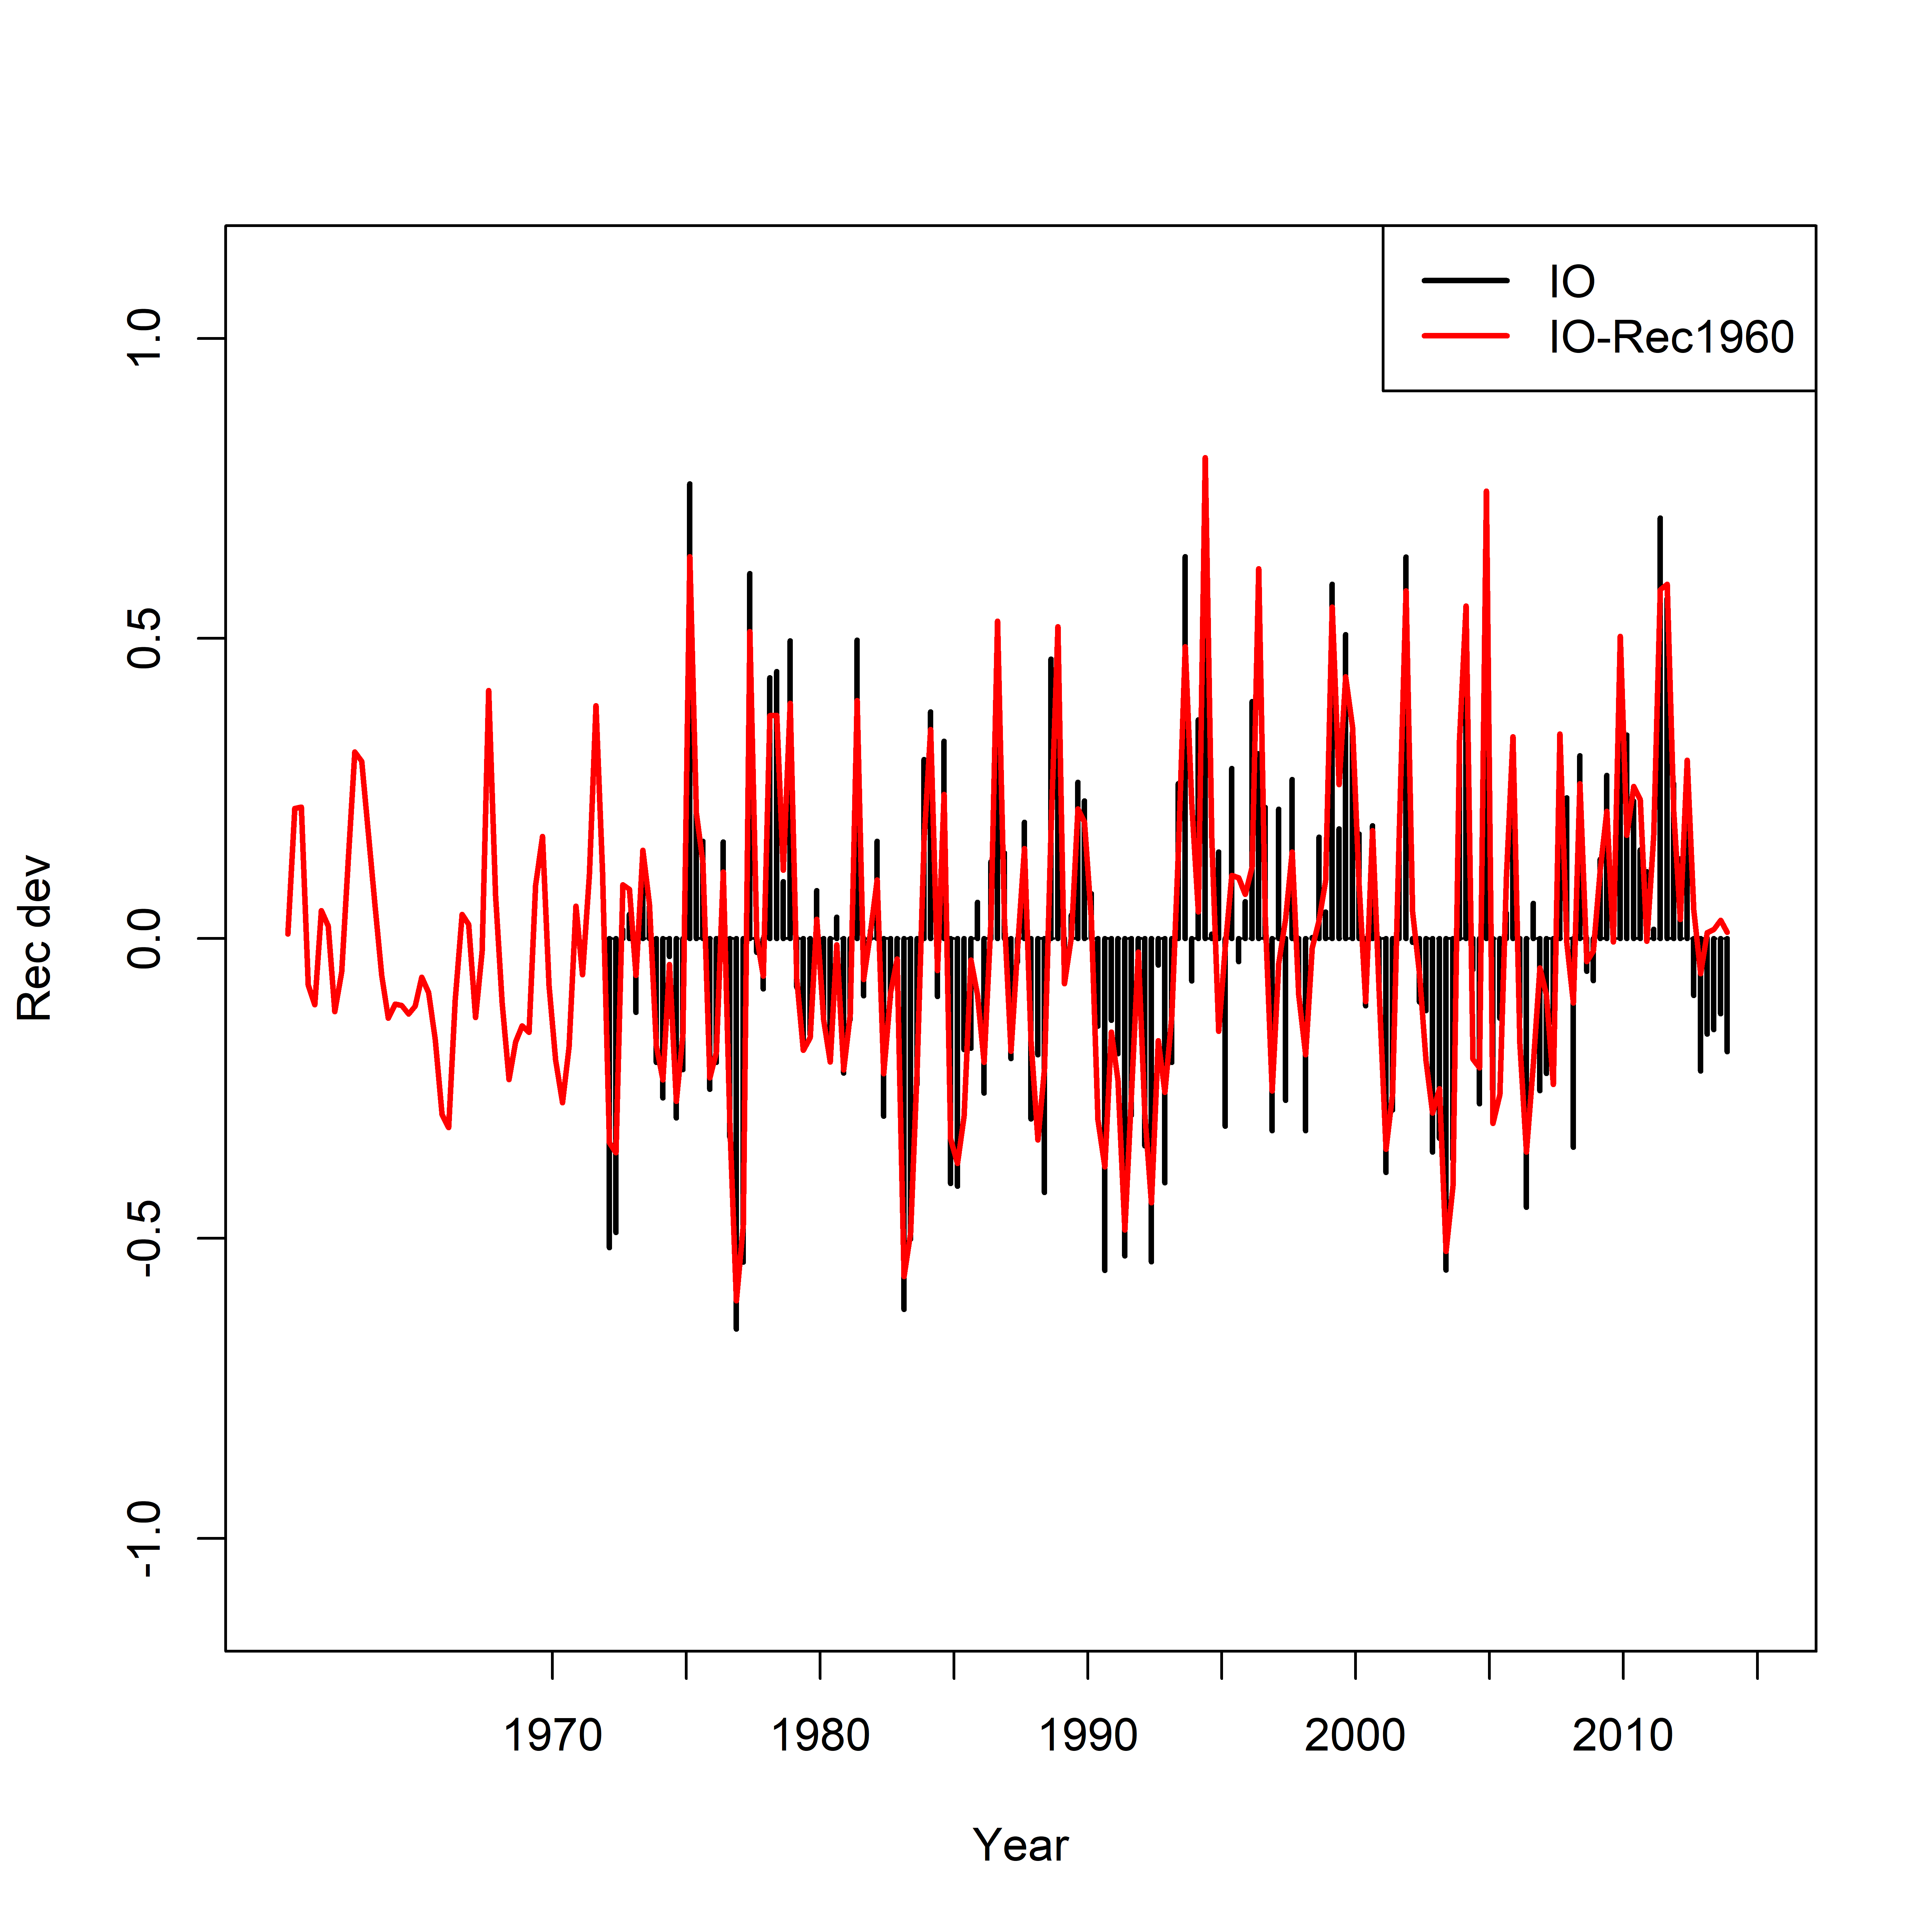
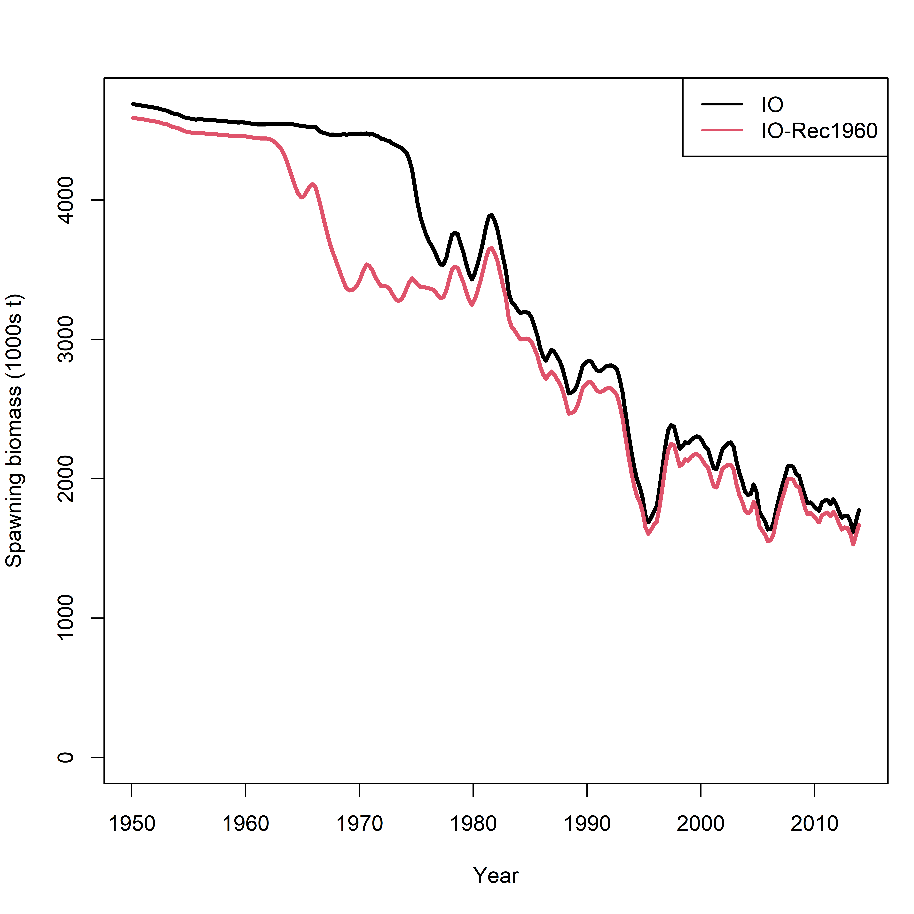
1-Area (IO)
How far back should rec dev be estimated
E.g., 1960 or 1970?

Slide 15
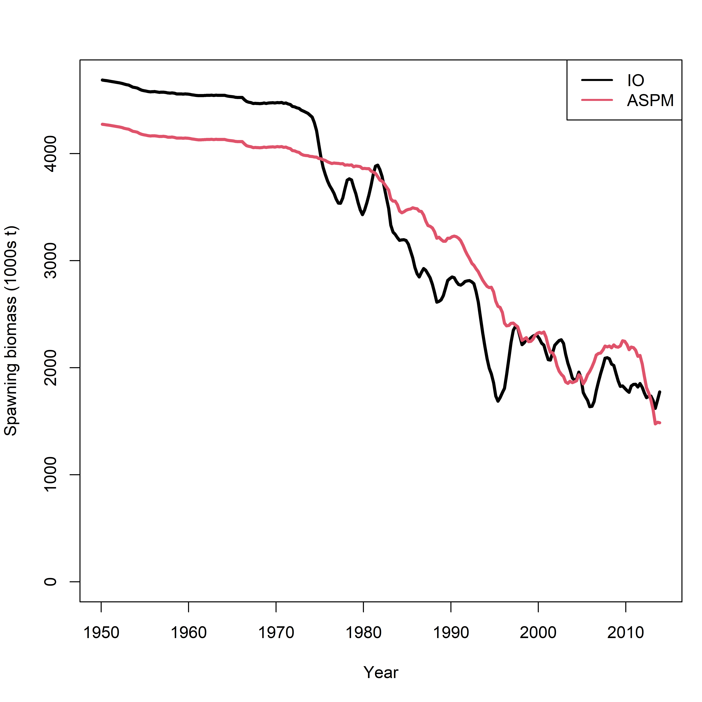
ASPM analysis (IO)
ASPM – Recruitment deviates fixed to 0 and length data removed
Overall consistency between CPUE and catch
Scaling parameter not unduly influenced by recruitment dev or length data

Slide 16
IO4 – CPUE
Fits to regional CPUE appears adequate, temporal deviates on regional recruitment distribution not necessary – usually not the case

Slide 17
IO4 – LF

Slide 18
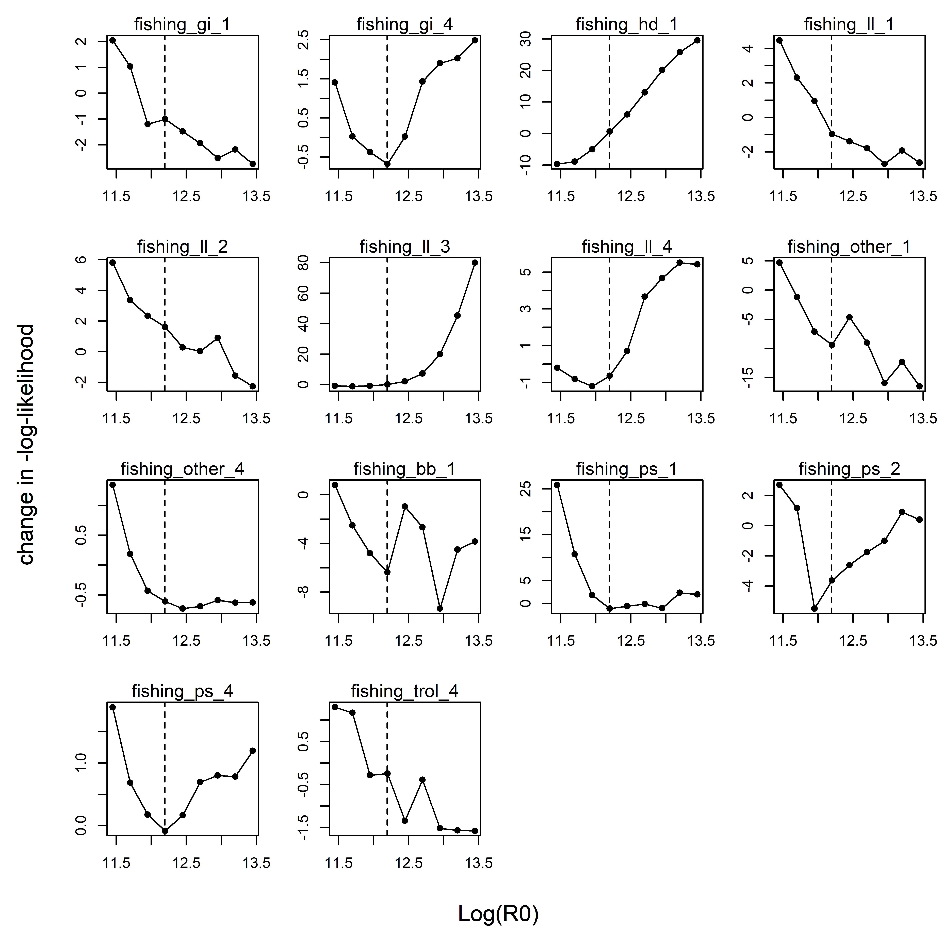
IO4 – LF
Trend in mean length from PS_1 not adequately captured, may need to consider increasing the sample size or time-varying selectivity

Slide 19
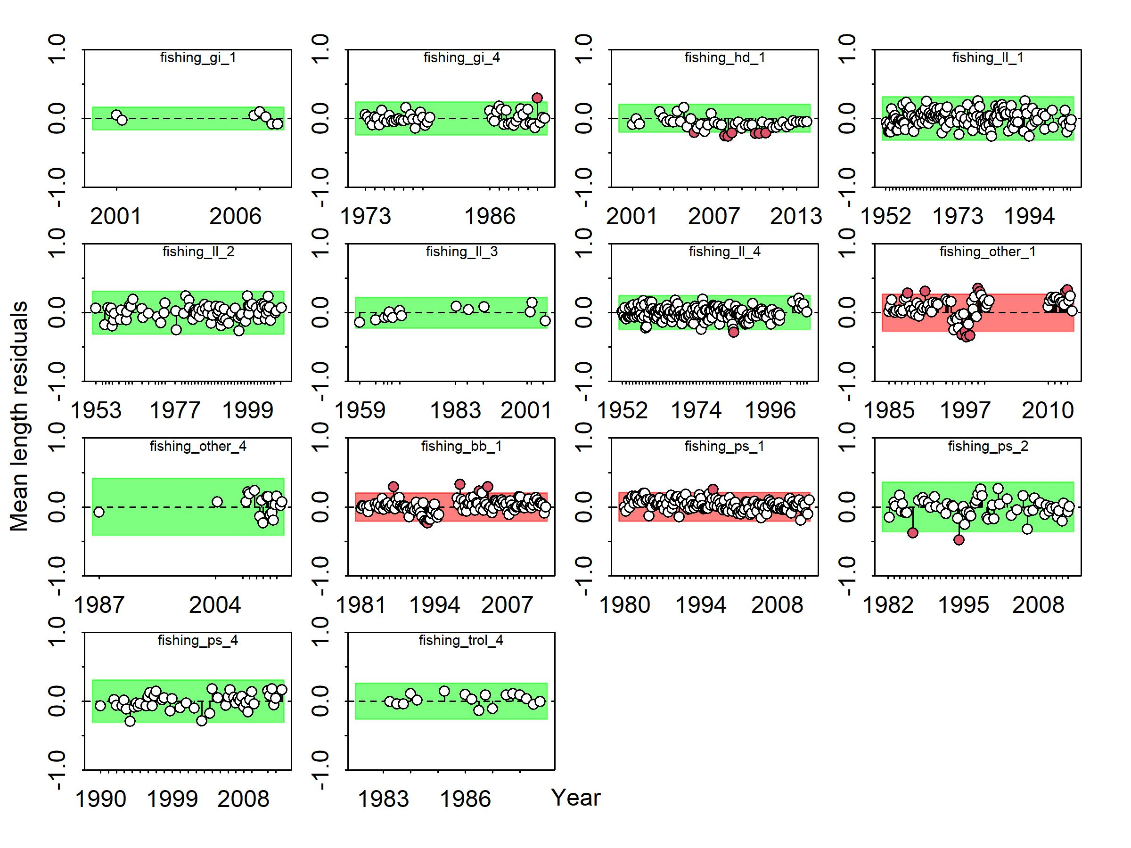

Slide 20
IO4 – Tag
IO4
IO4-revised
Conditioning on release groups if there are > 2 tag returns after the mixing period had little effect

Slide 21
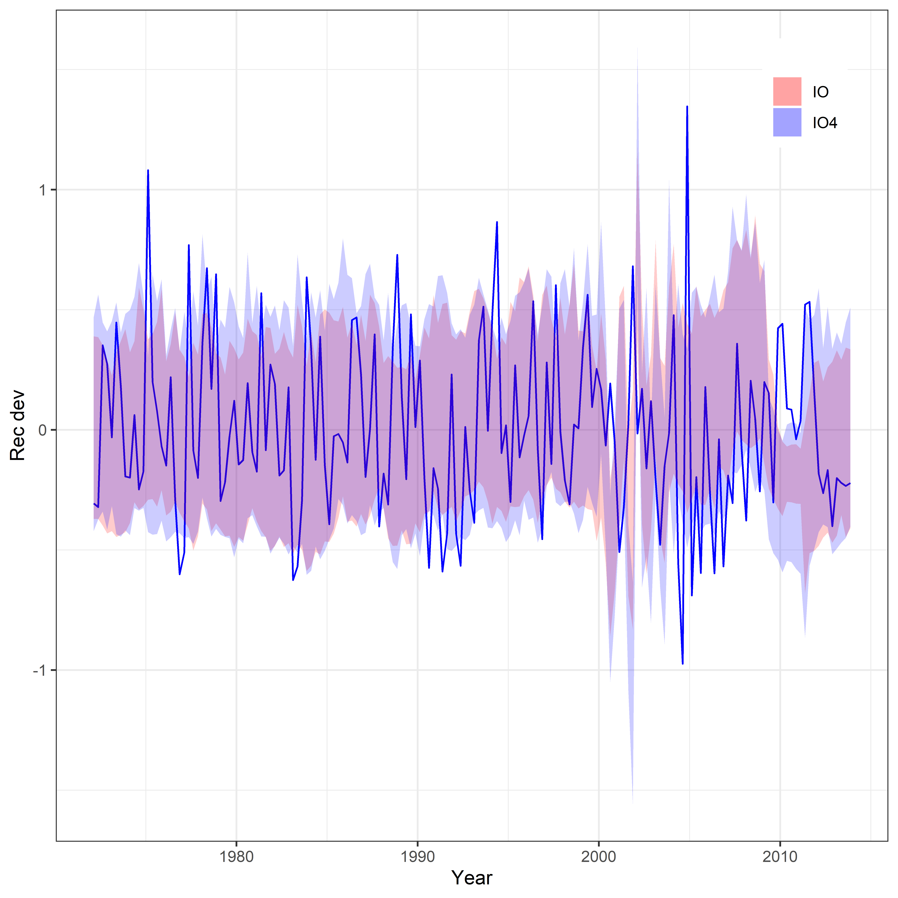
Recruitment – IO vs IO4

Slide 22
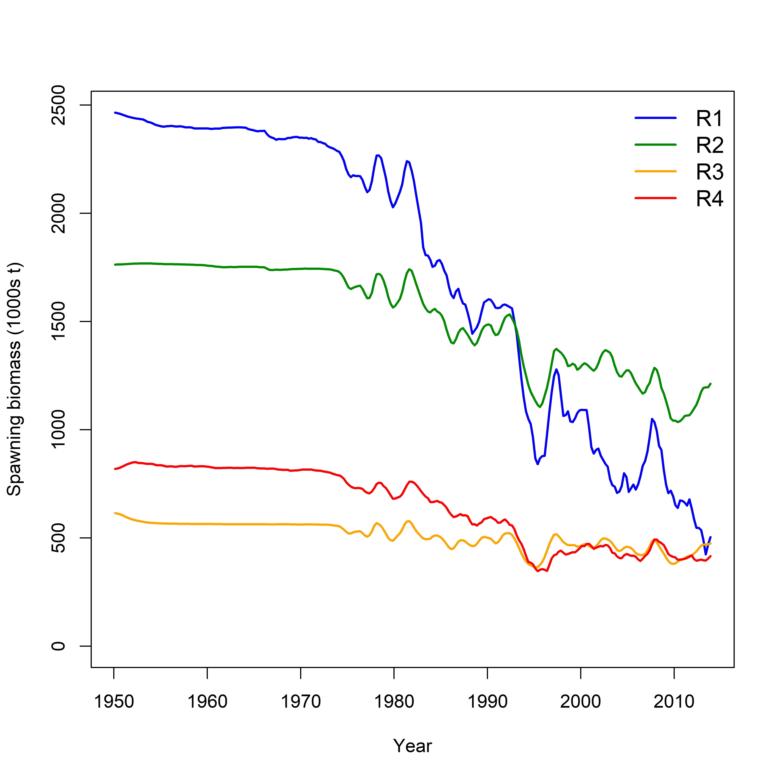
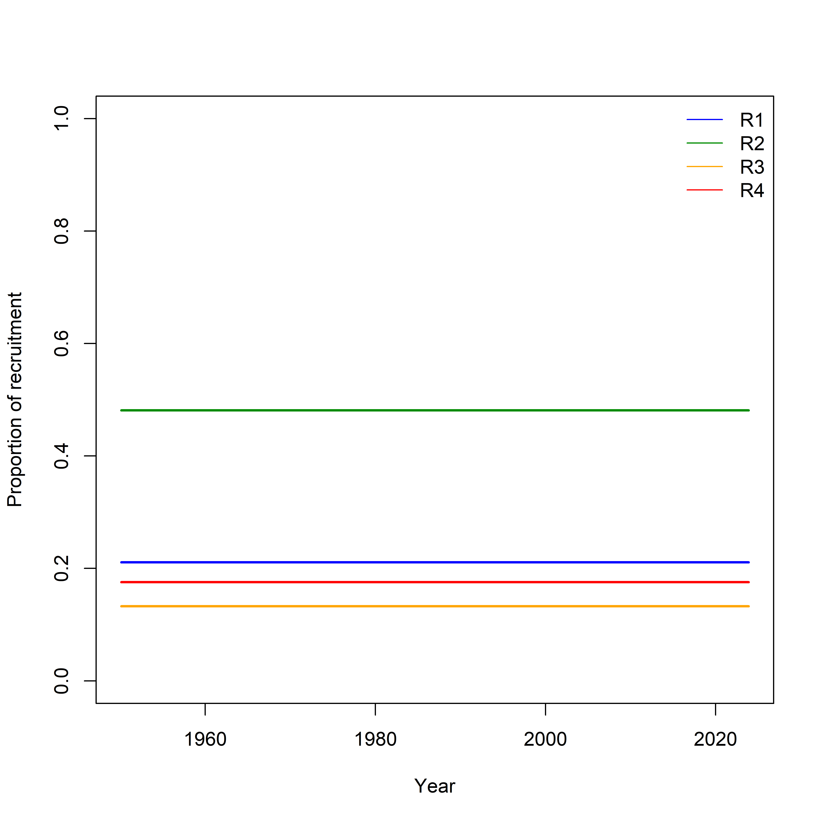
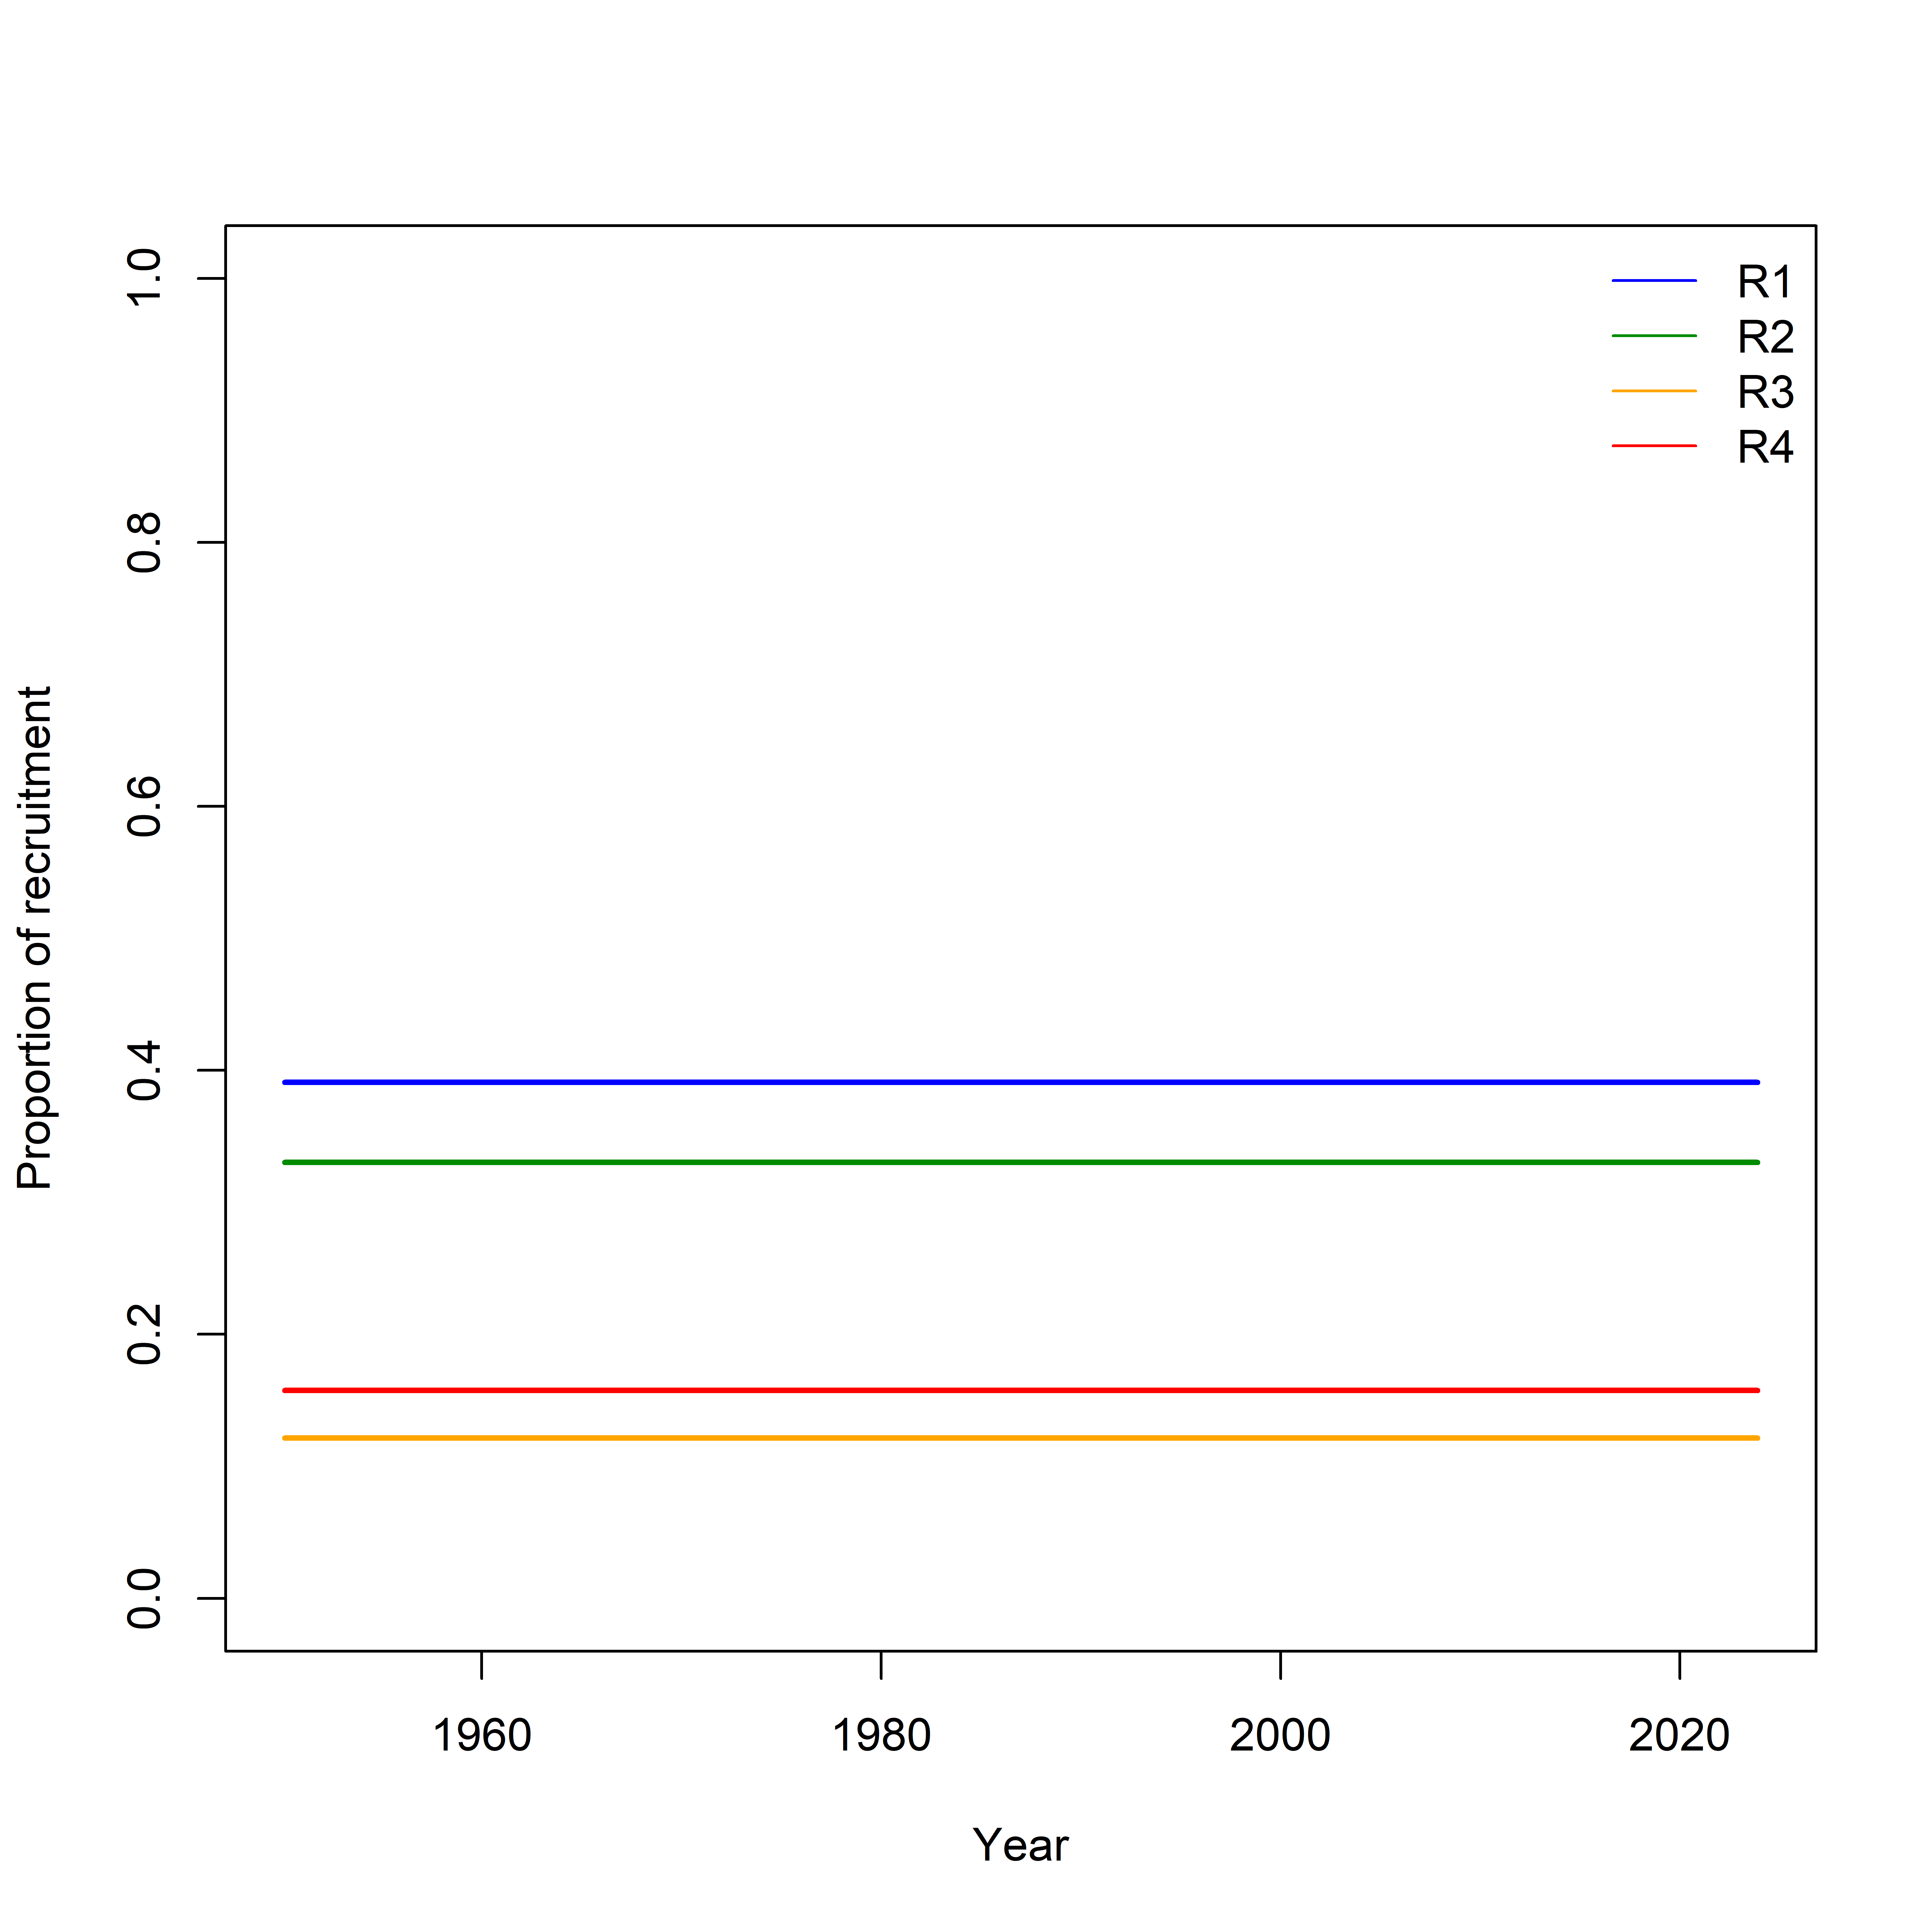
Biomass / recruitment distribution
IO4
IO4 – No movement
Prior on regional biomass distribution (shared CPUE q) is essential
Estimation of recruitment apportioning may have been confounded with movement

Slide 23
Movement
No information on adult movement
R1 -> R2 probably informed mostly by tagging data
R2 -> R1 probably confounded with recruitment distribution
Difference in LL length comp between areas may influence movement also

Slide 24
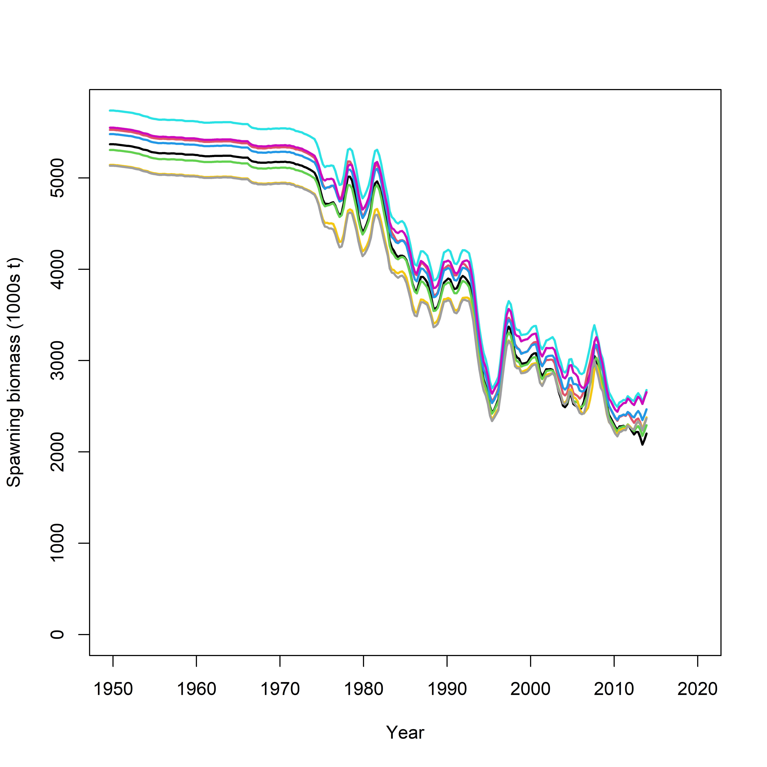
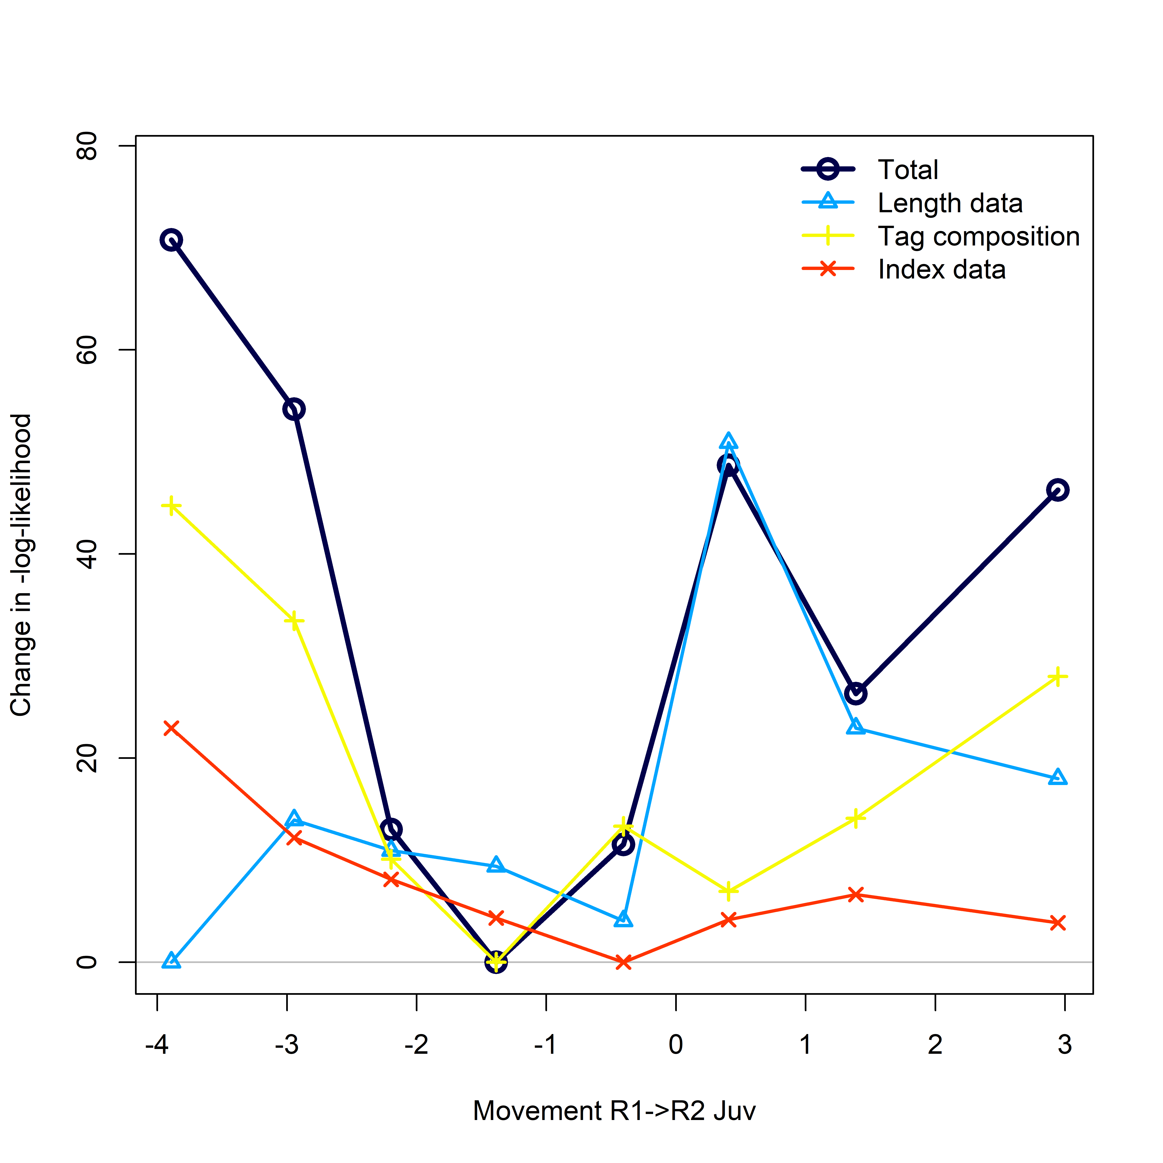
Profile on R1–>R2 movement
The Model is not sensitive to movement rates as long as movement is allowed

Slide 25
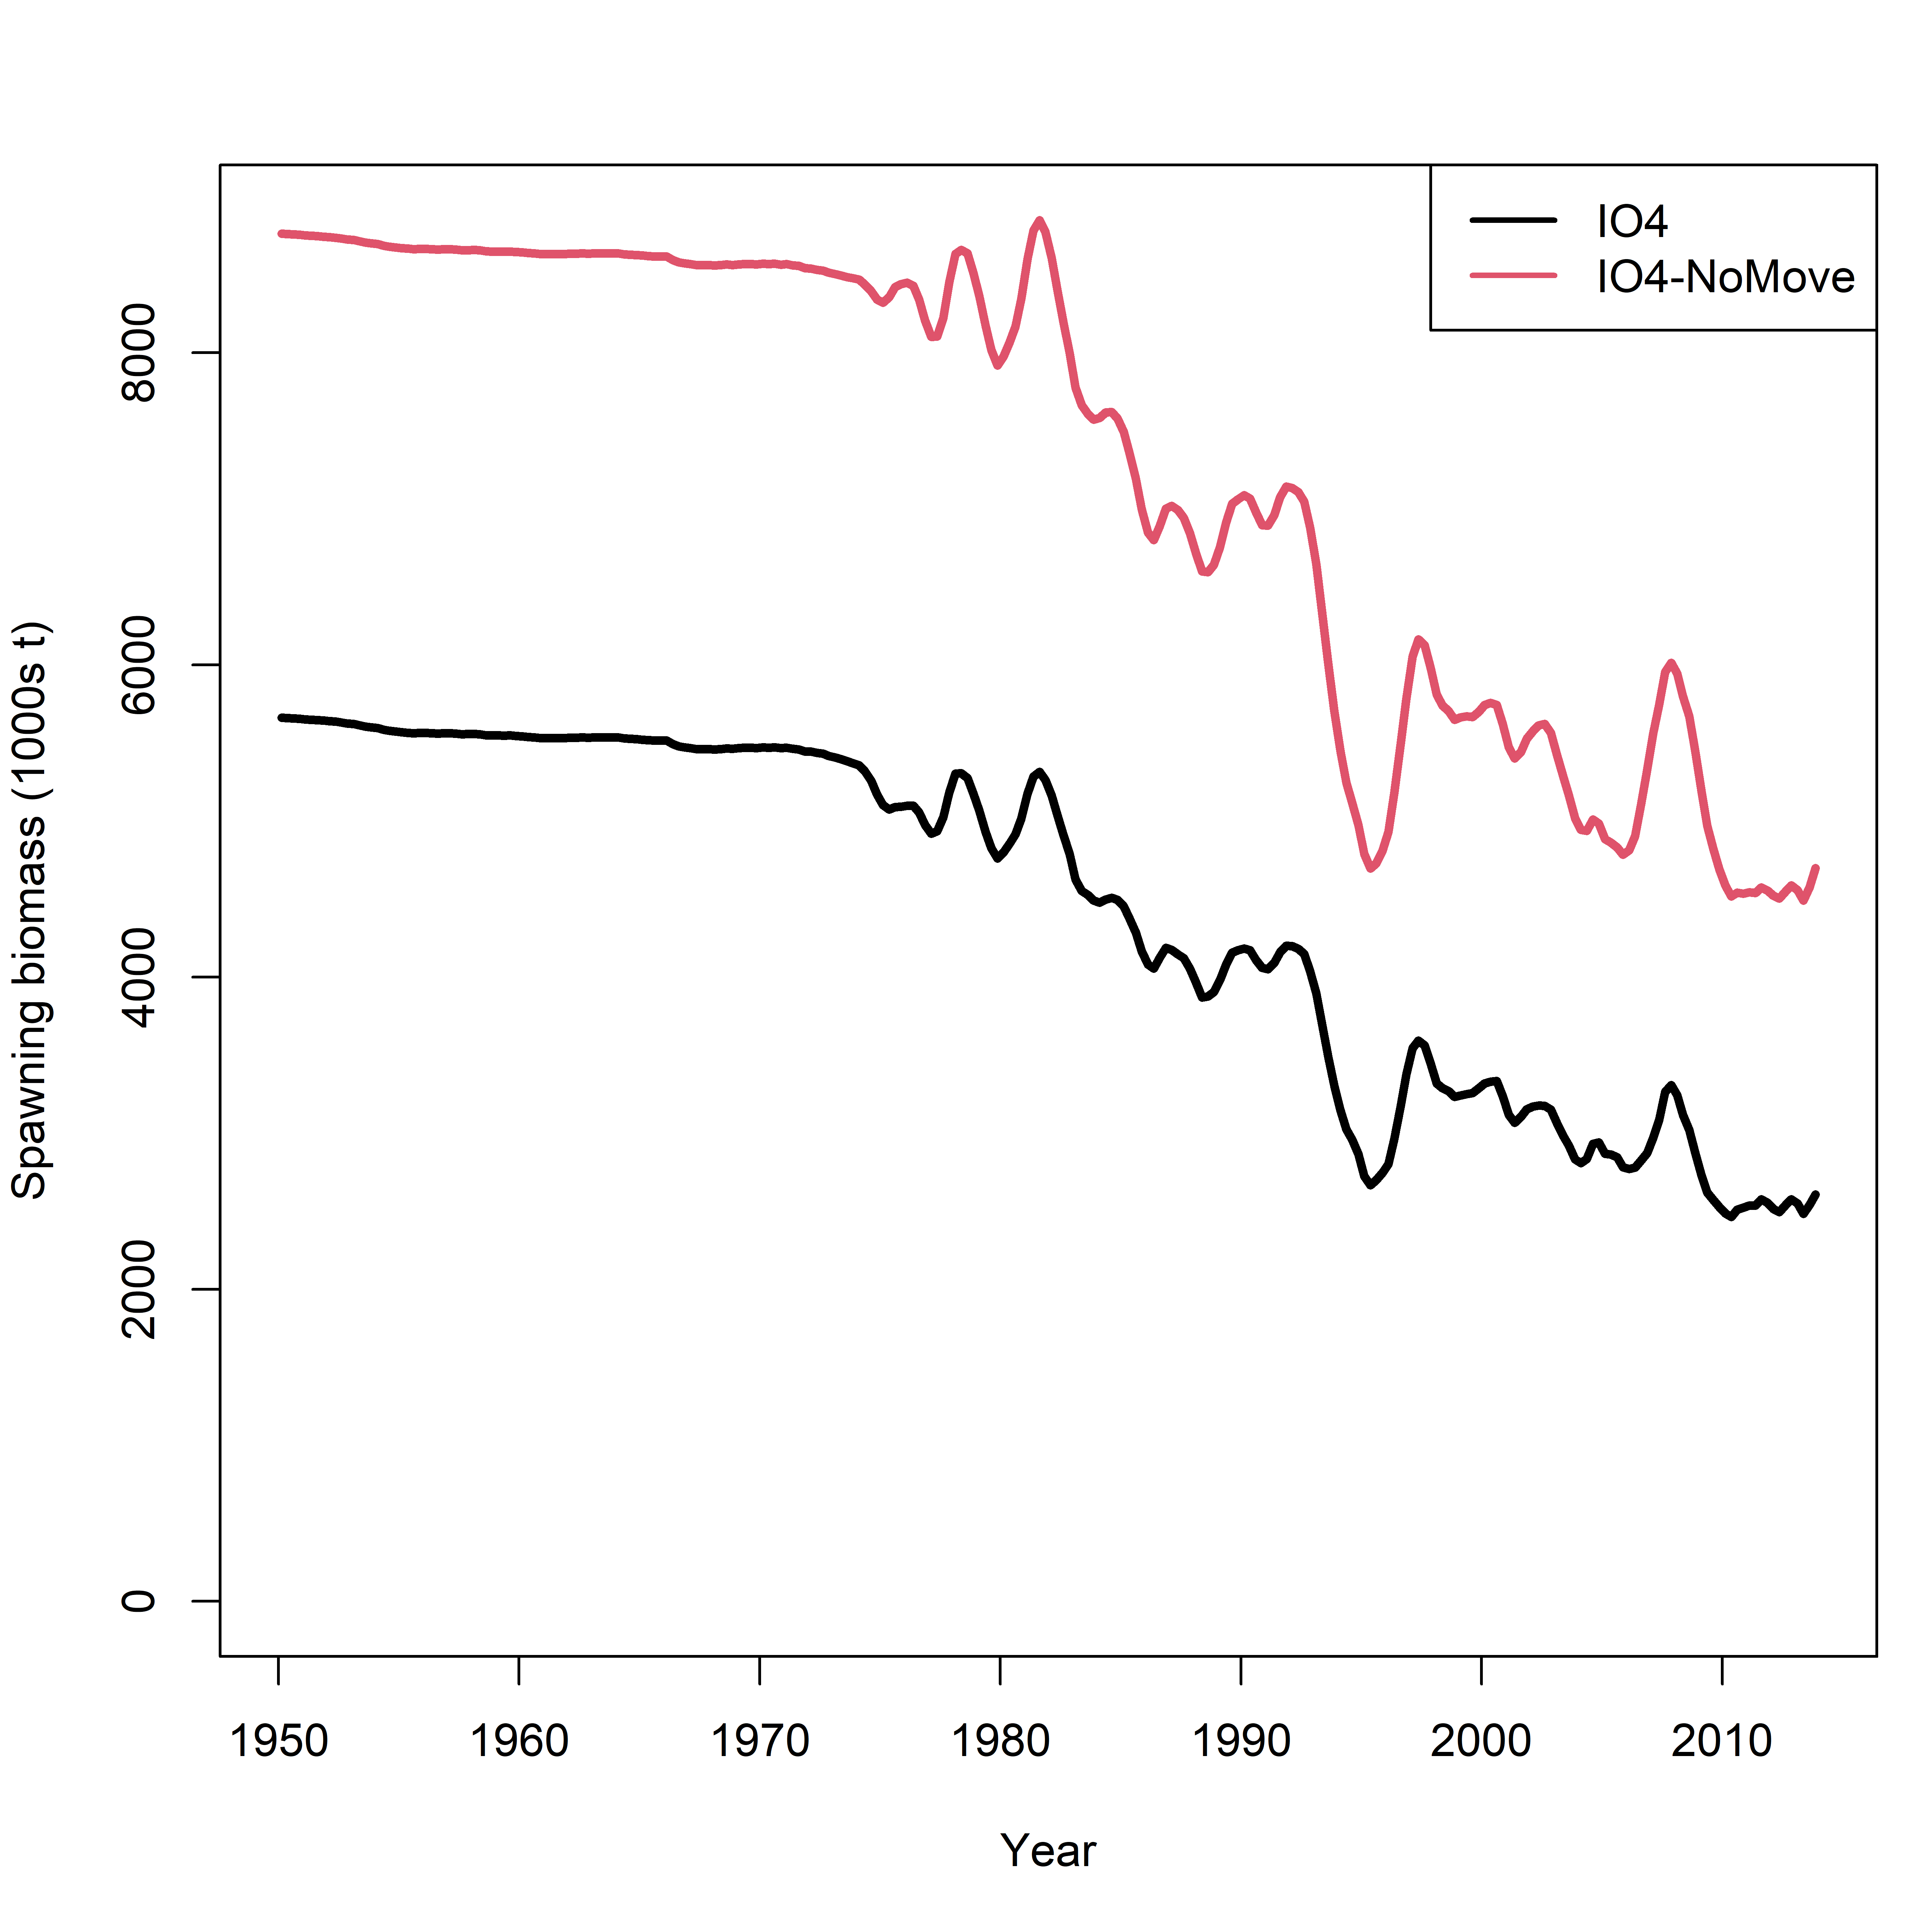
Spatial Model with no movement
But assuming no movement significantly increase biomass, possibly due to catch constraint in each region

Slide 26
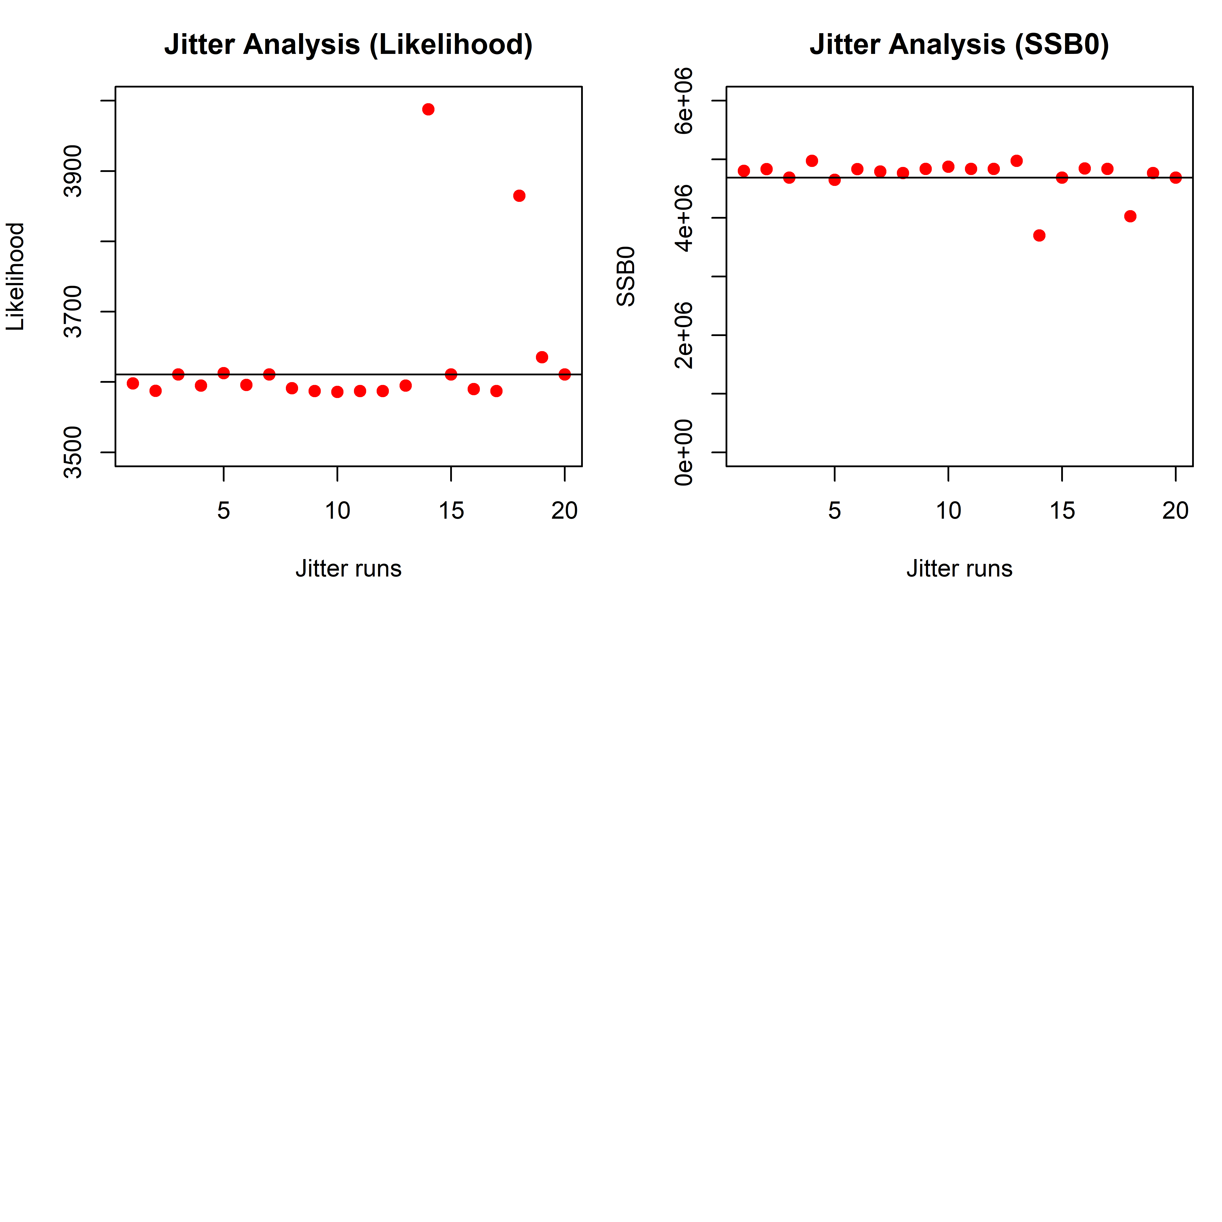
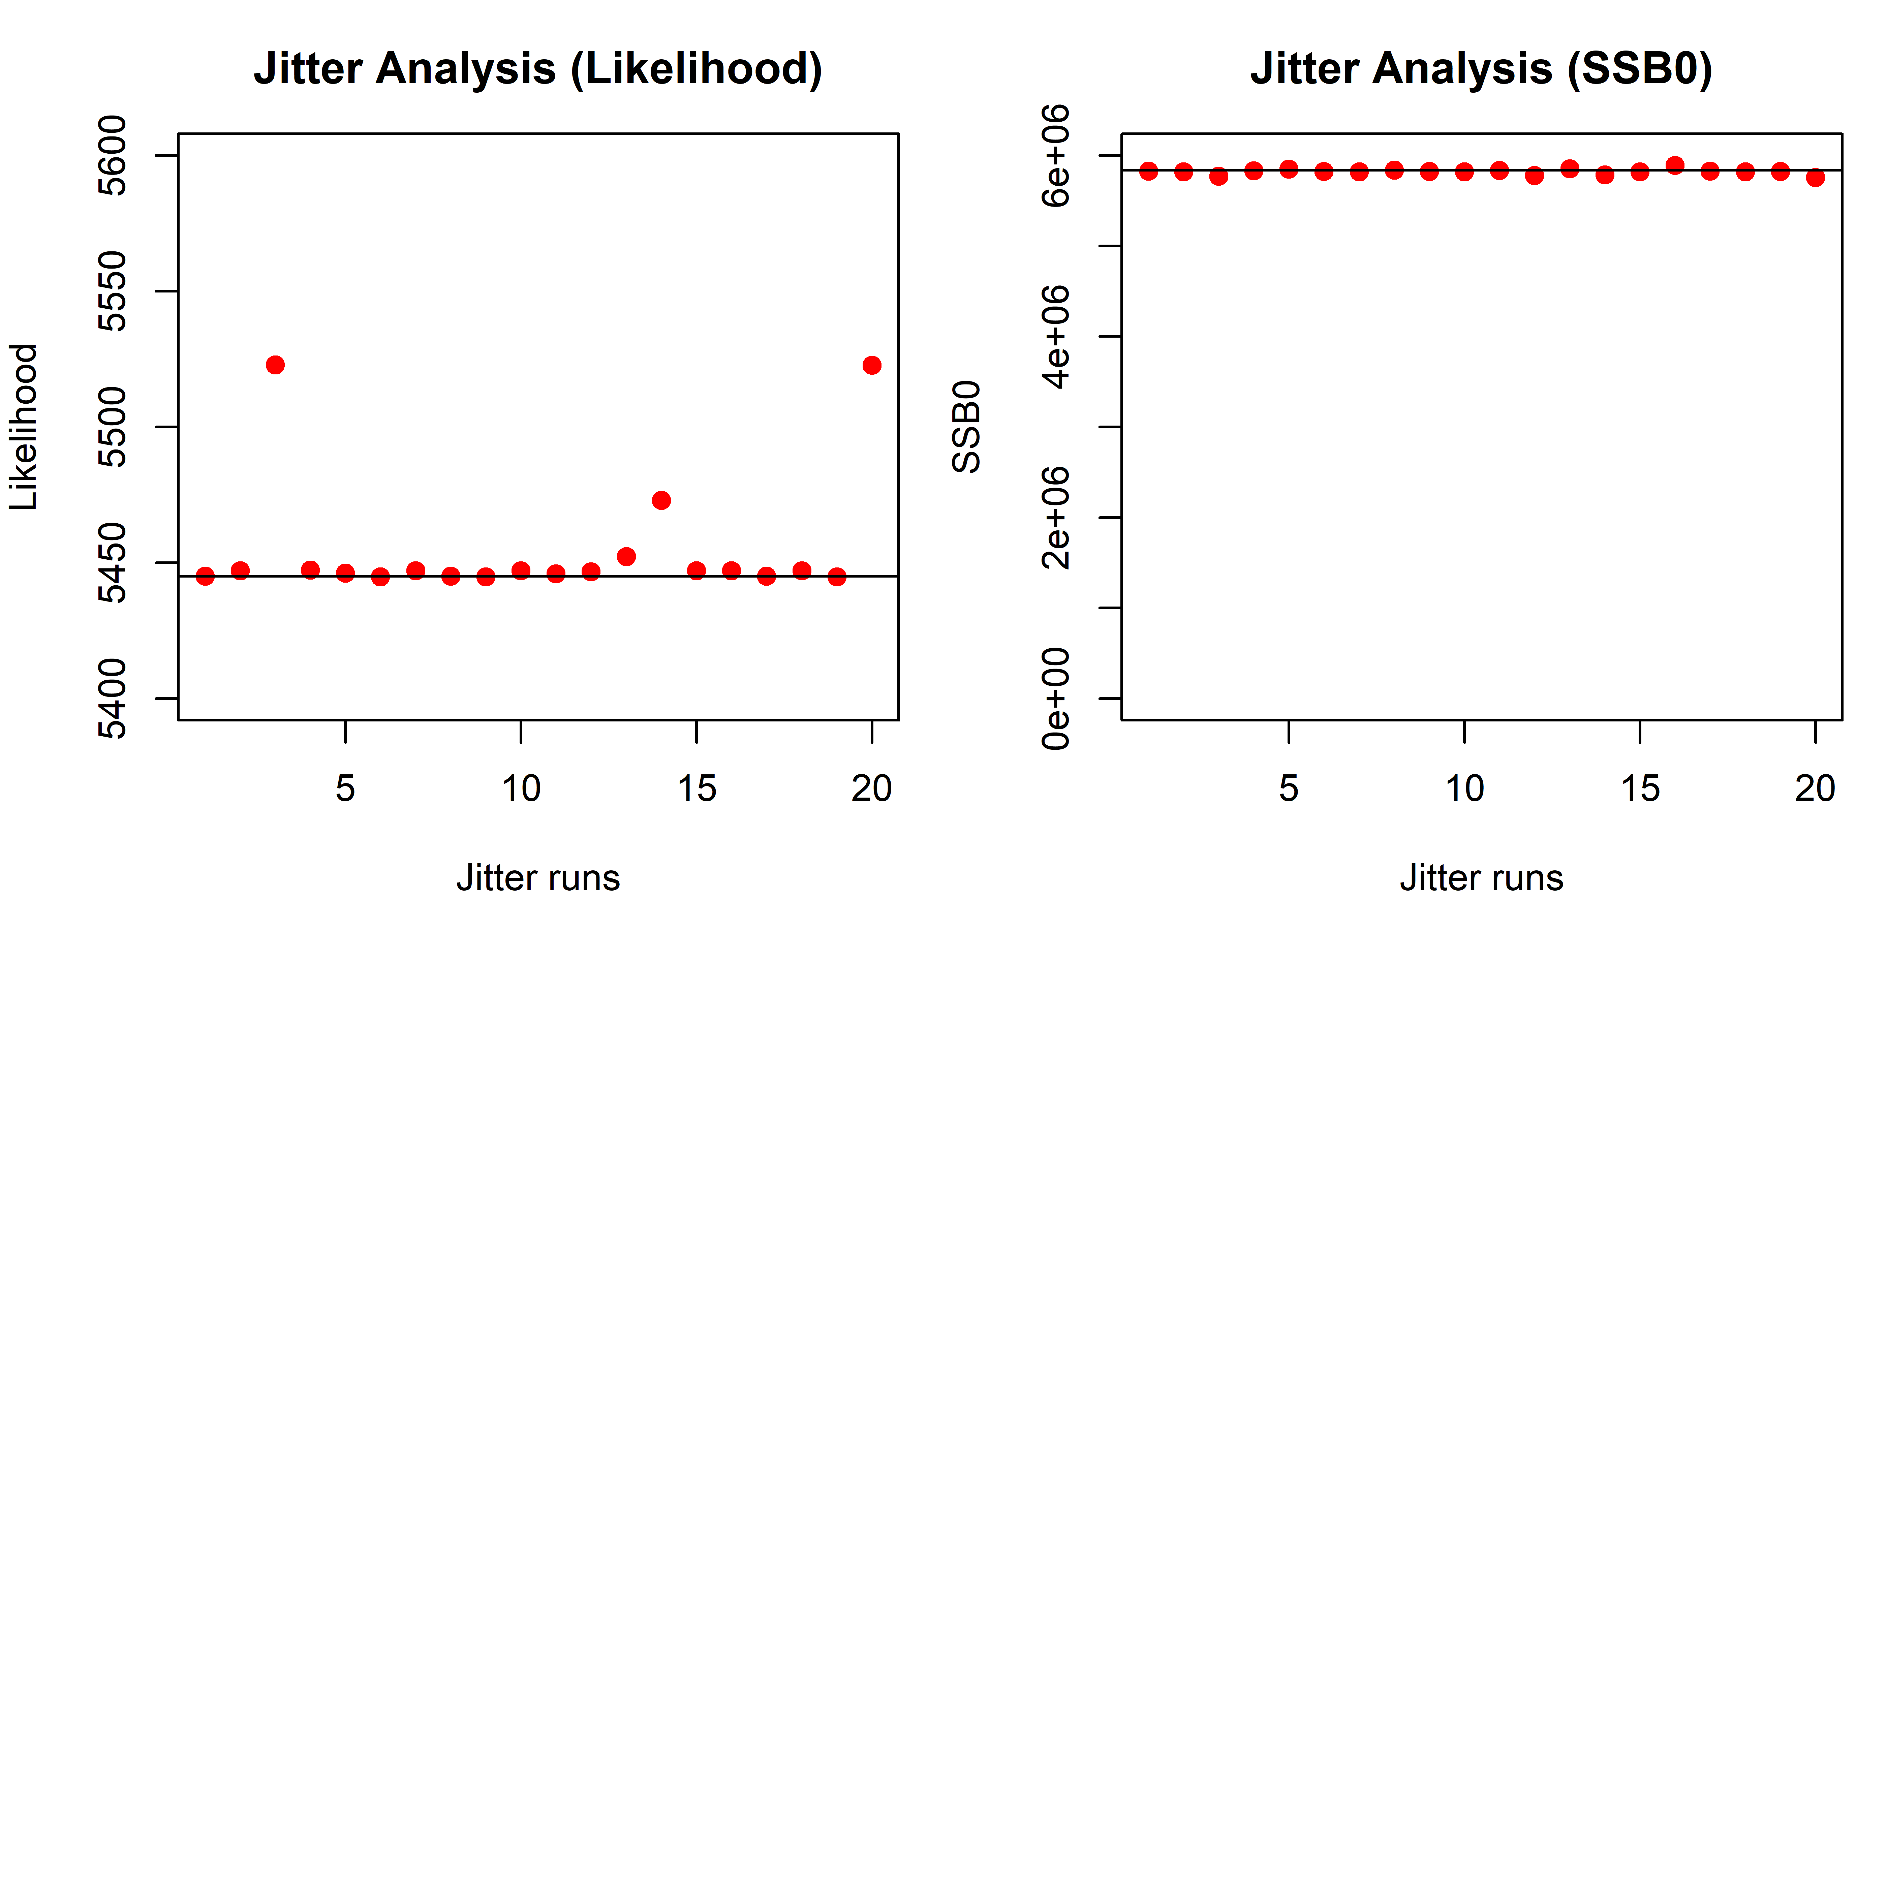
Jitter
IO
IO4

Slide 27
Retrospectives – IO4

Slide 28
Temporal structures
Quarter-as-Year vs. Year/Season
SS is flexible in setting up both structures
Model follows finer quarterly age (quarter-as-year), or annual age but tracks fish with different seasonal birthday (year/season)
Underlying population processes are approximately similar (recruitment, growth, selectivity, tag age assignment)
The Year/Season model can estimate seasonal effects on movement
Source of structure/model uncertainty?

Slide 29
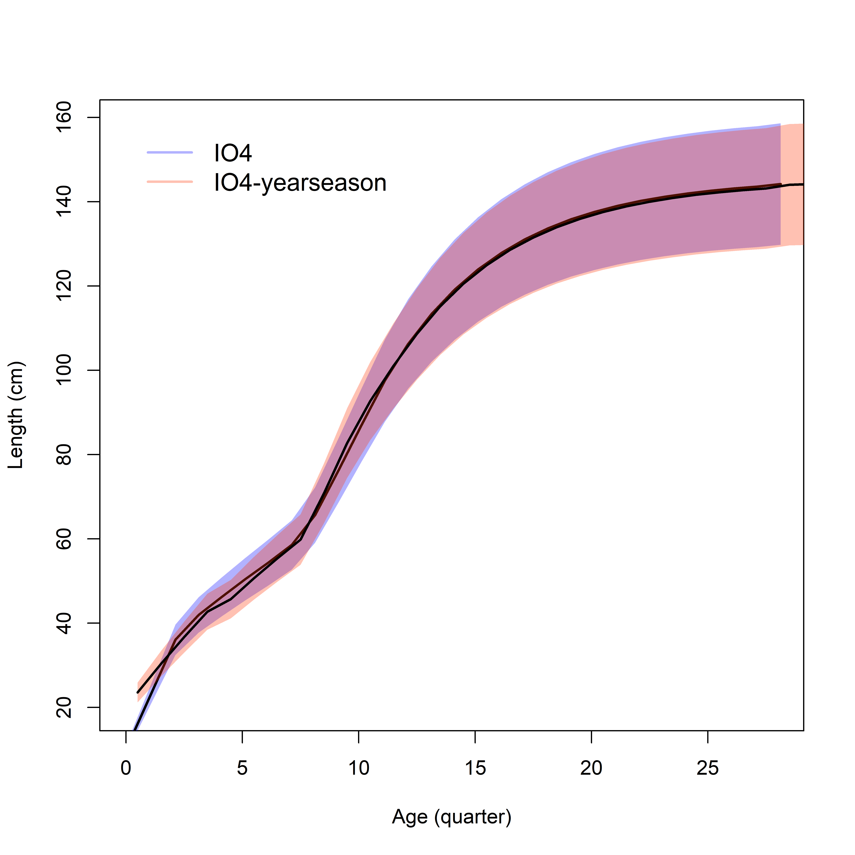
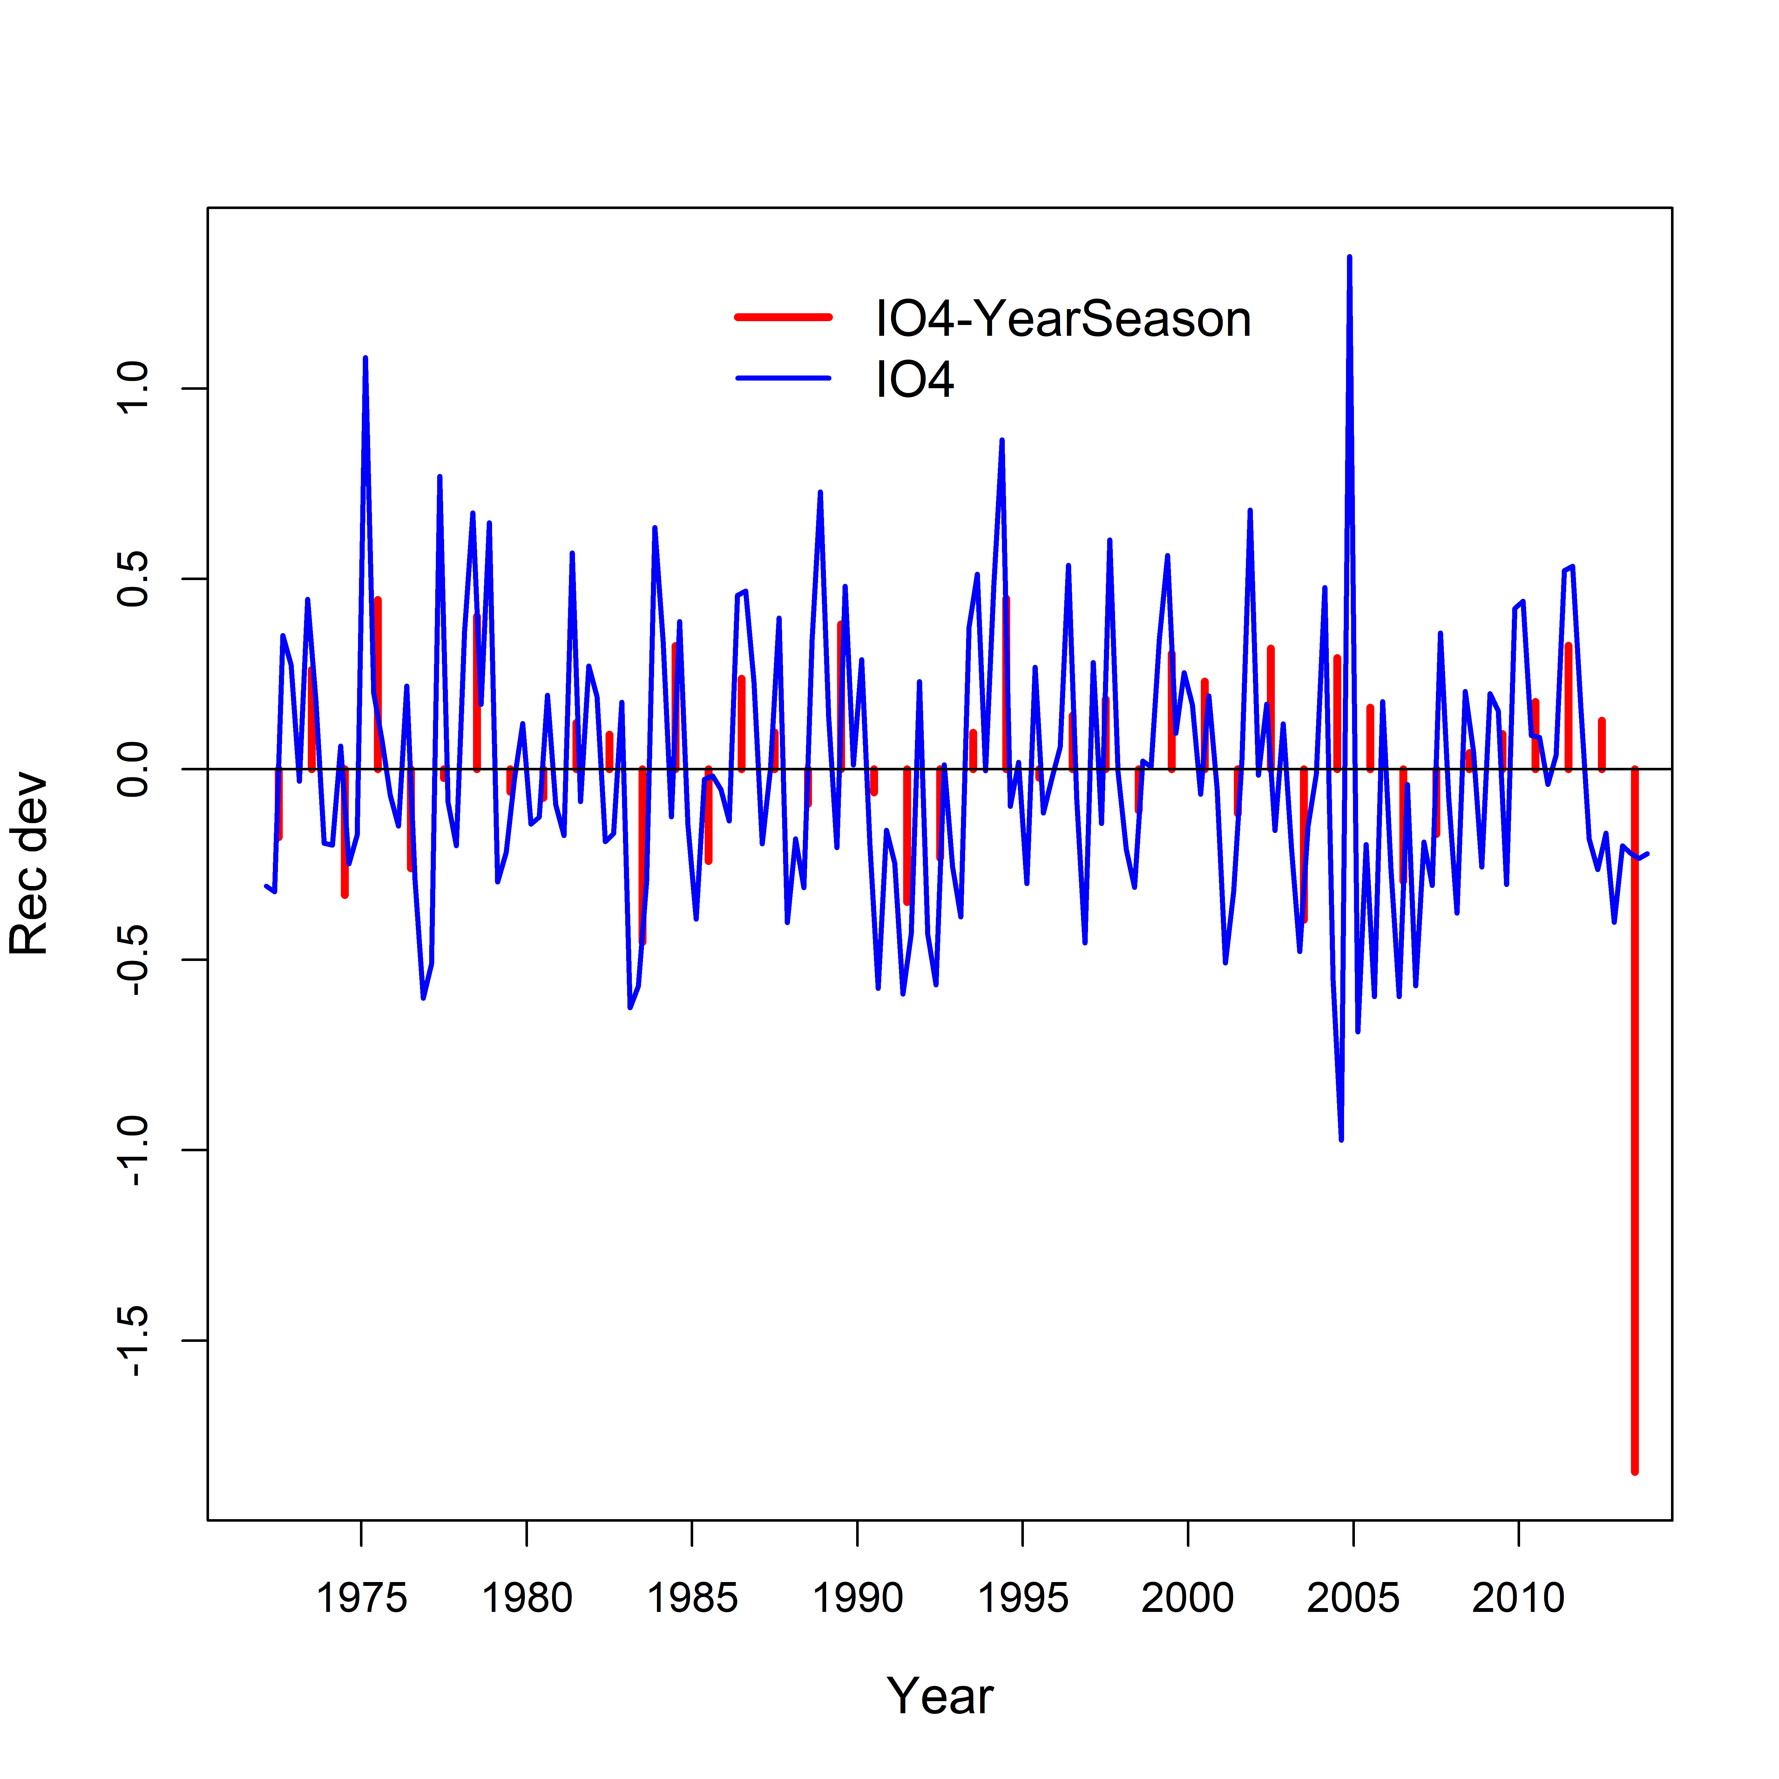
Temporal structures

Slide 30
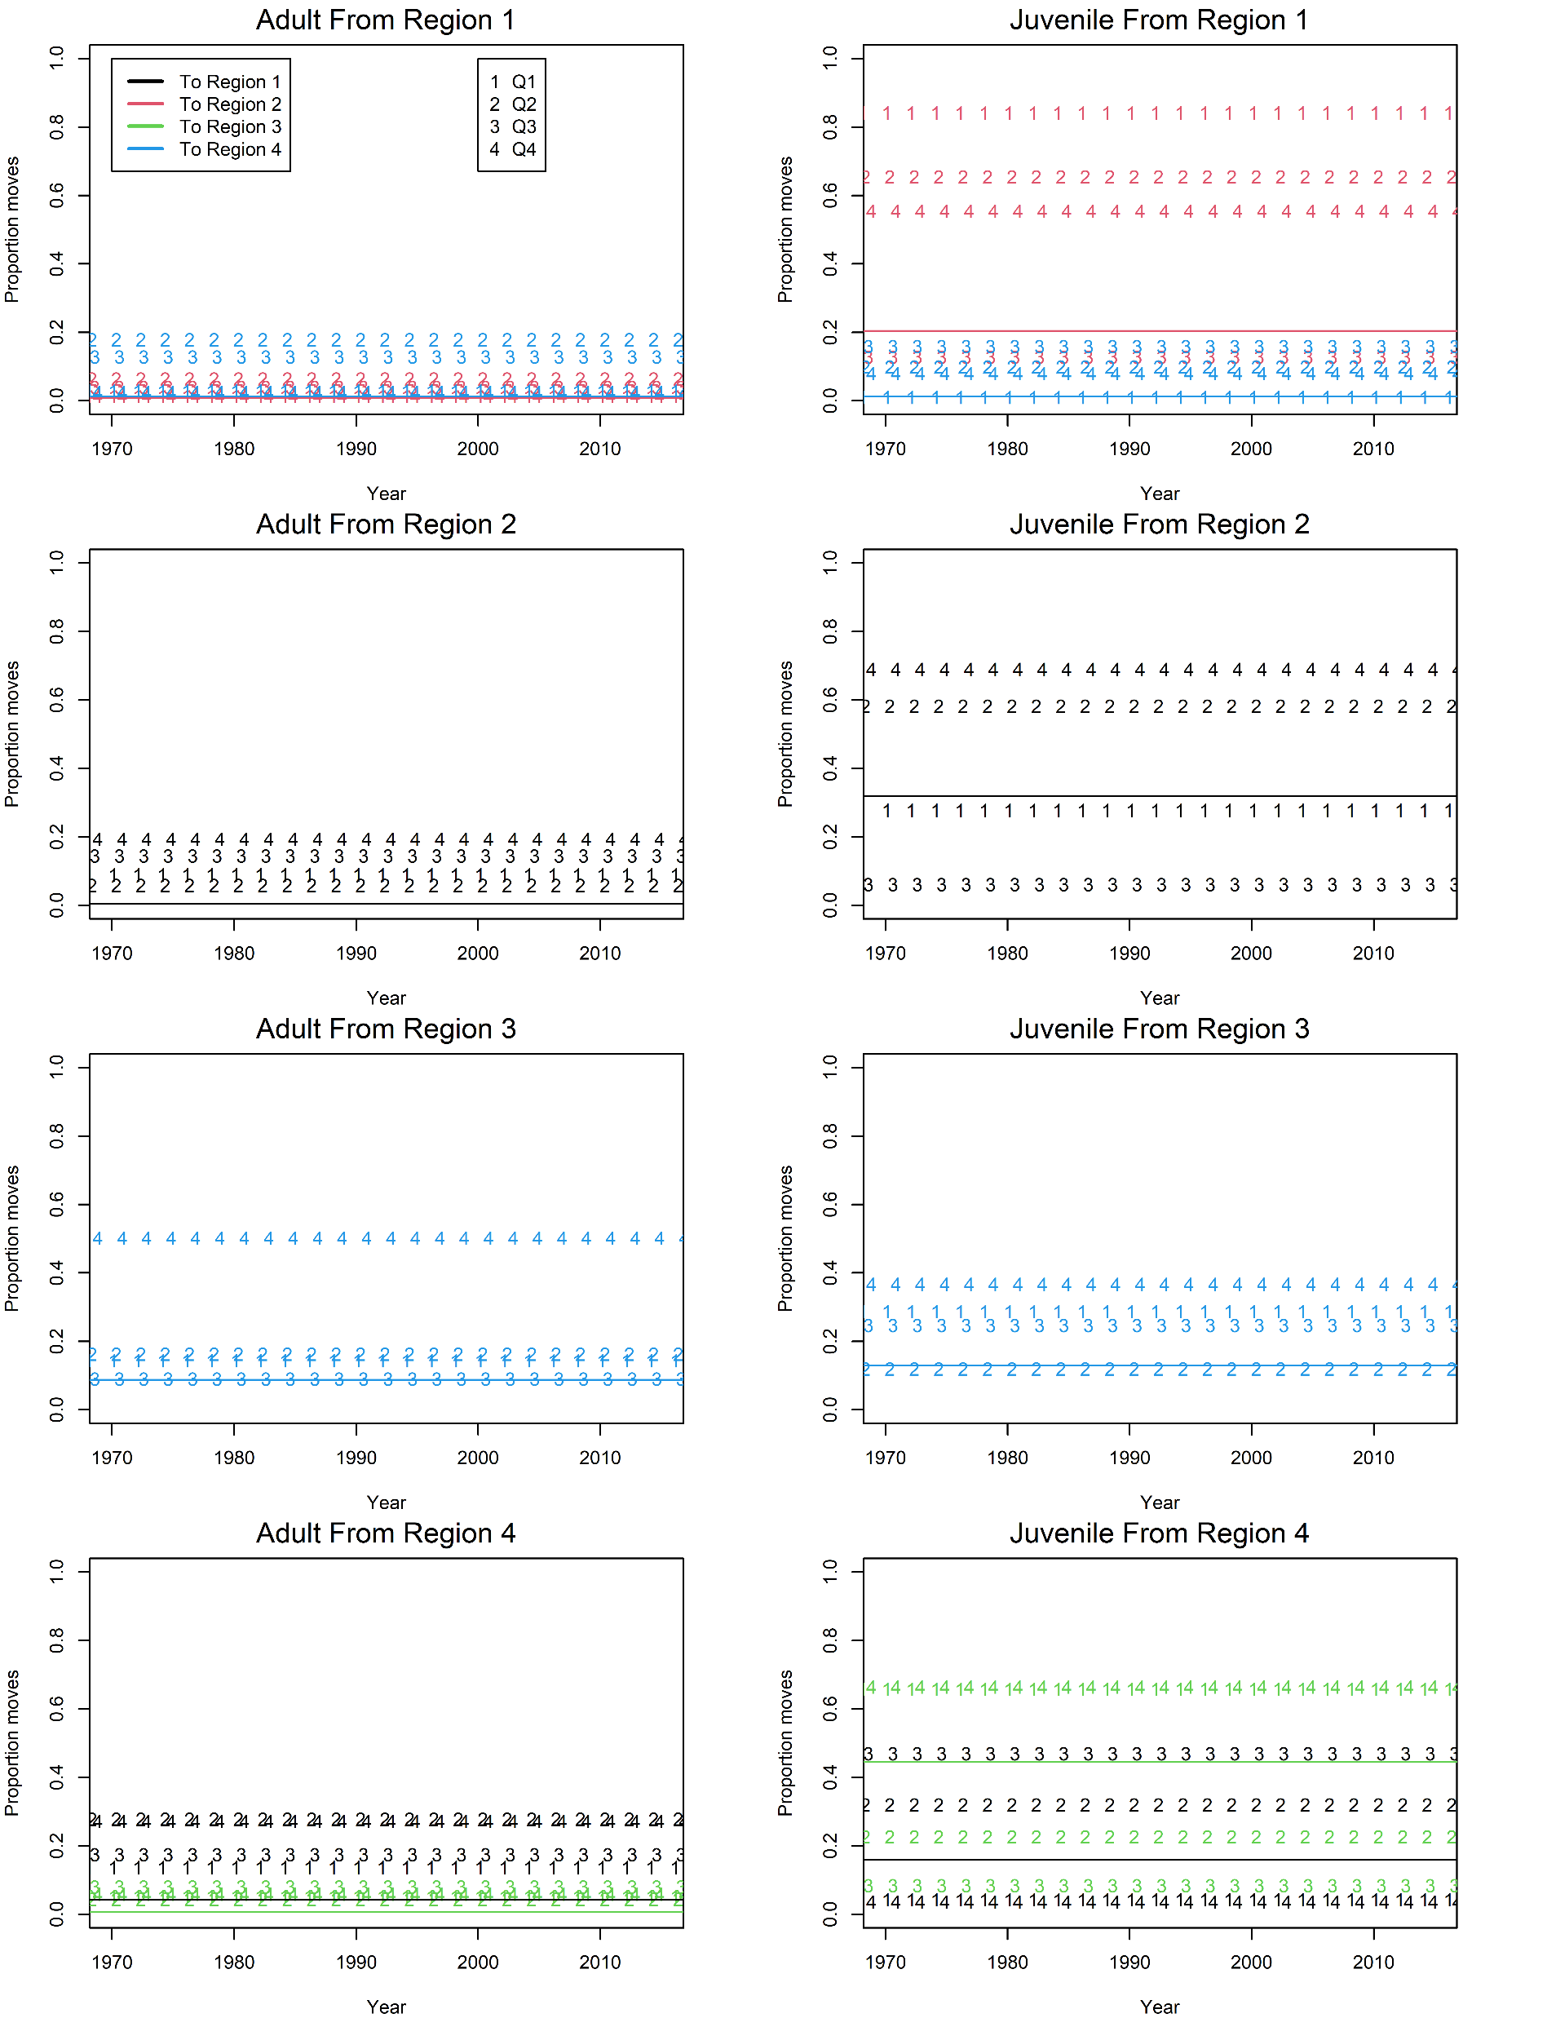
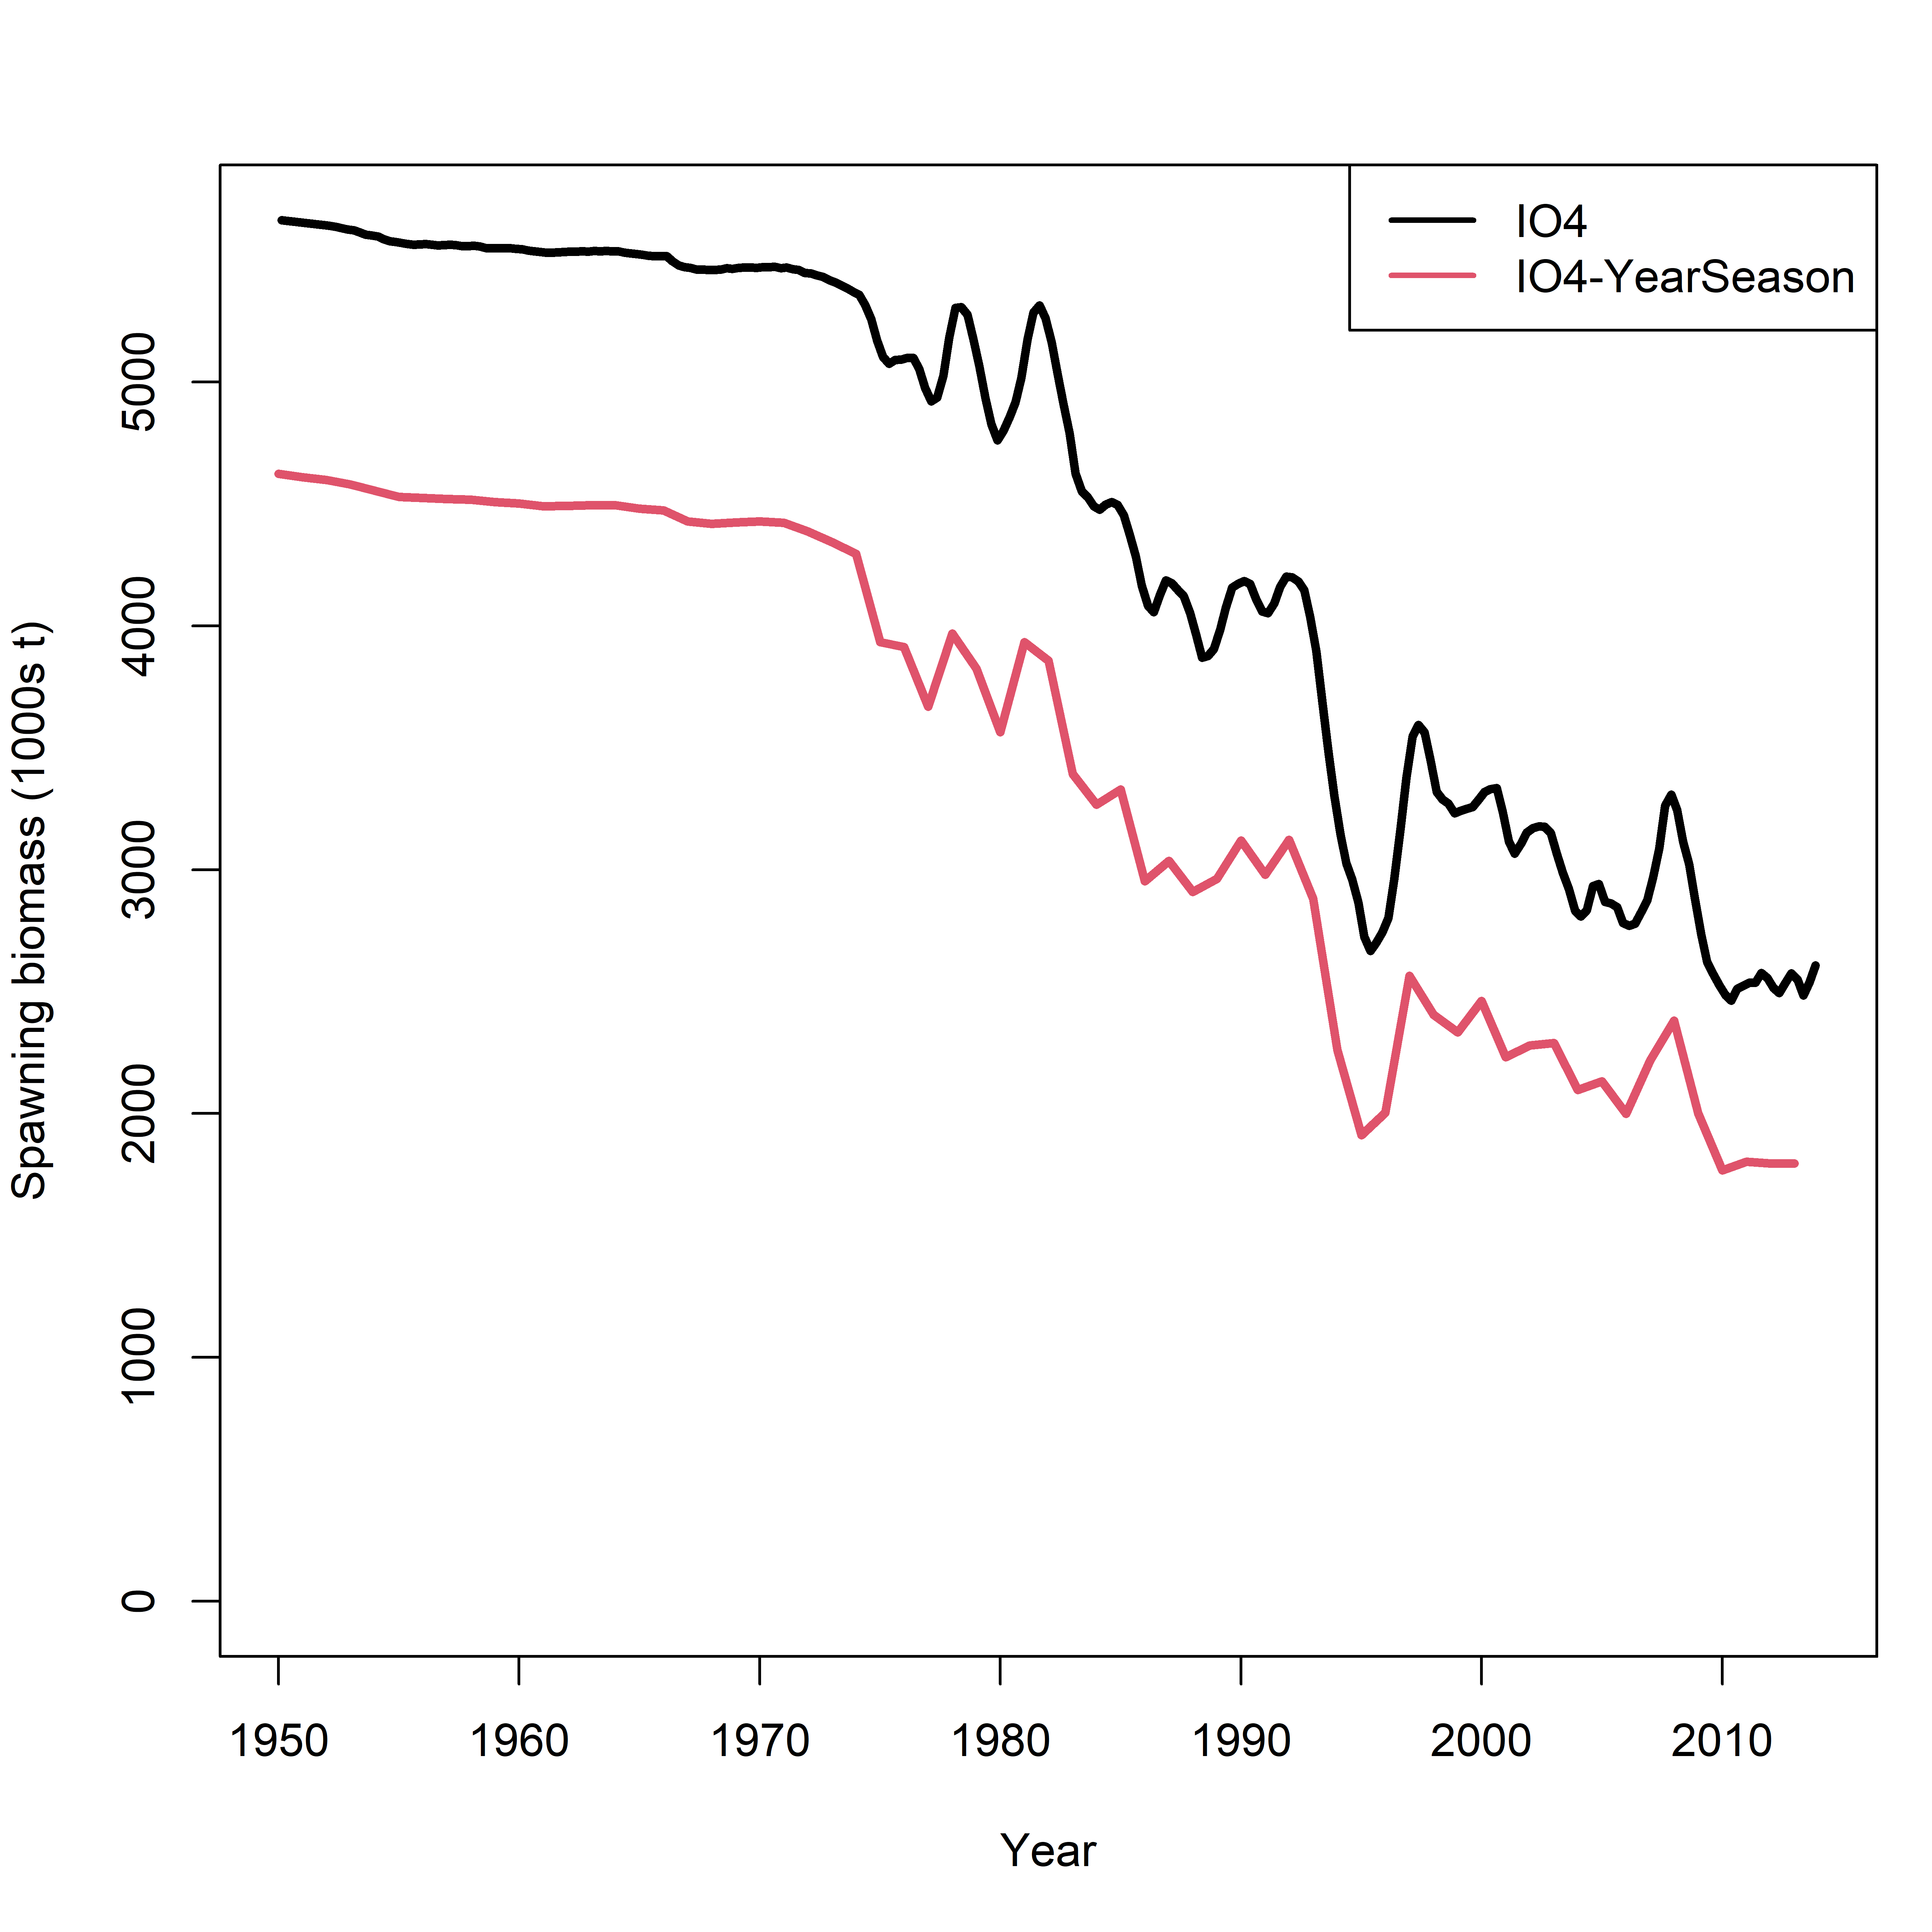

Slide 31
Diagnostic – mean length

Slide 32
Summary
IO4 and IO model are generally consistent in estimating the scaling parameter/trend when tag data are not used
Tag data are influential so setting-up appropriate regional structure to account for difference in tag mixing is important
It appears that estimation of abundance / fishing mortality is more essential than movement rates
Estimates of regional recruitment / movement more driven by model structure/assumption than the data
Temporal structure is also a potential source of model uncertainty and requires some considerations

